Slide 1
Approaches to development cooperation for effective health system support in conflict affected/ fragile settings
IHP+. UHC2030 23rd June 2016
Nigel Pearson

Slide 2
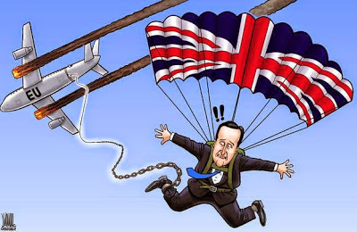
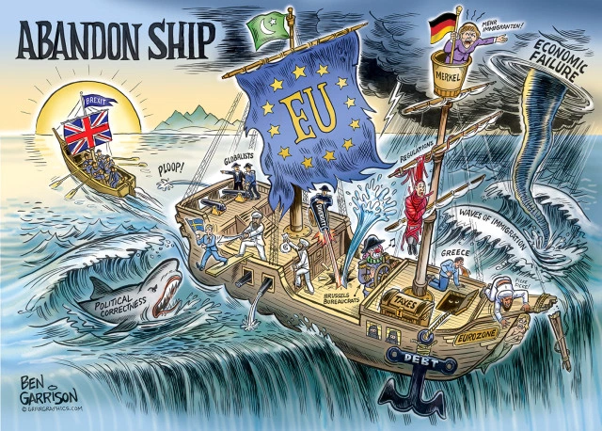
All states may experience fragility……

Slide 3
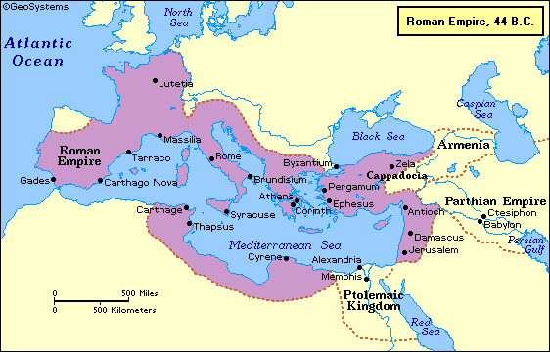
Changing perspective - visualising the context

Slide 4
Networks of the Roman world, 200 CE

Slide 5
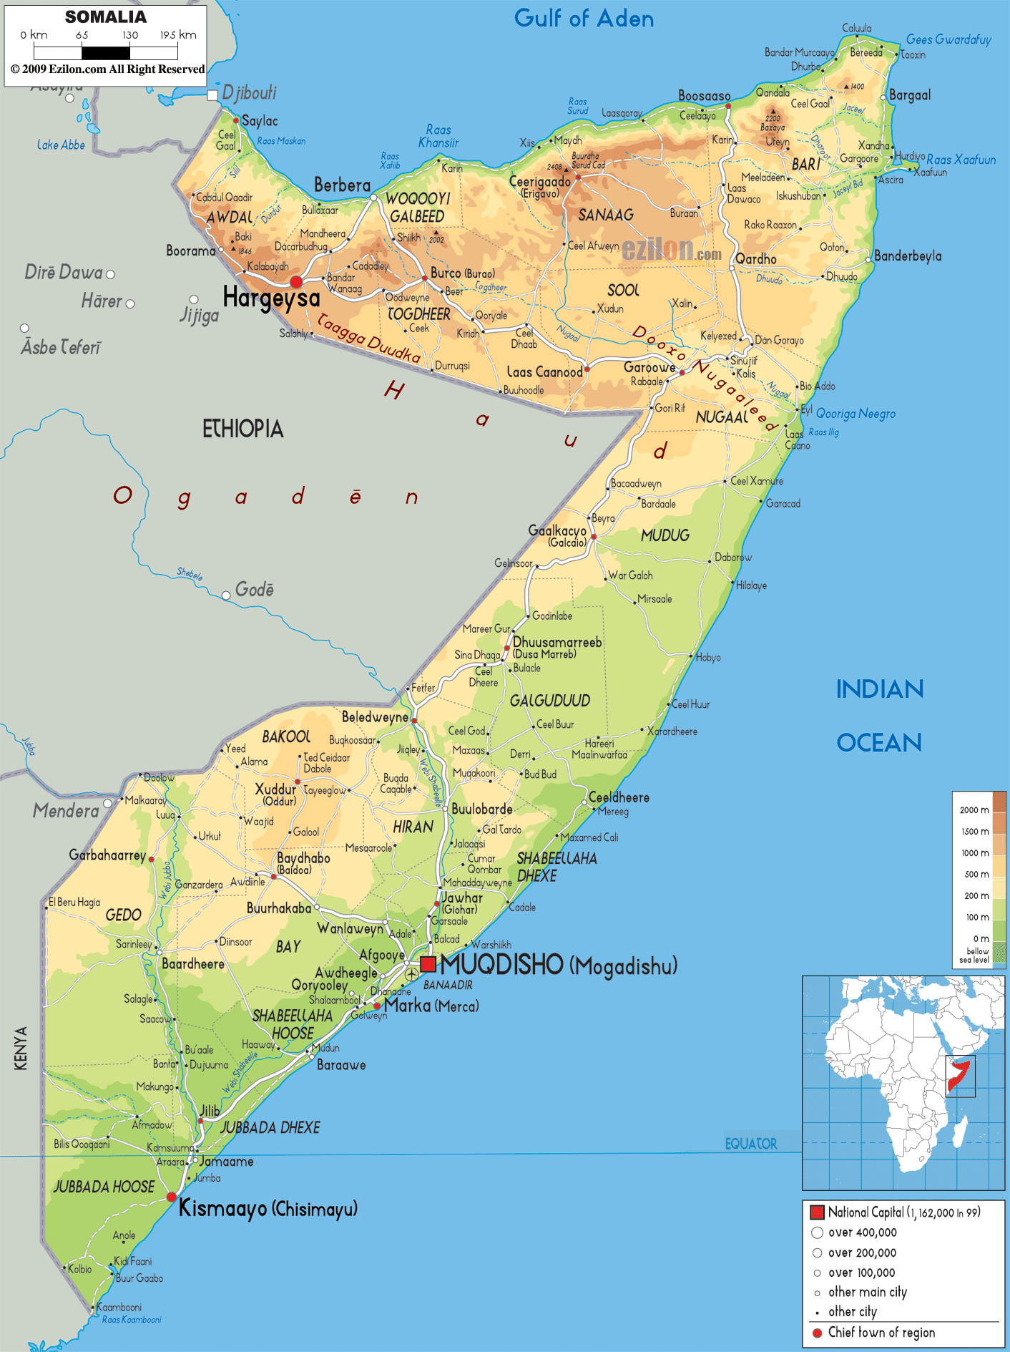

Slide 6
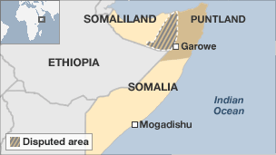
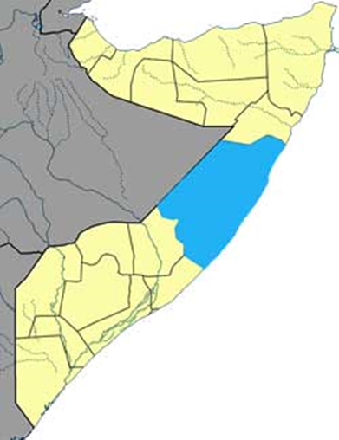
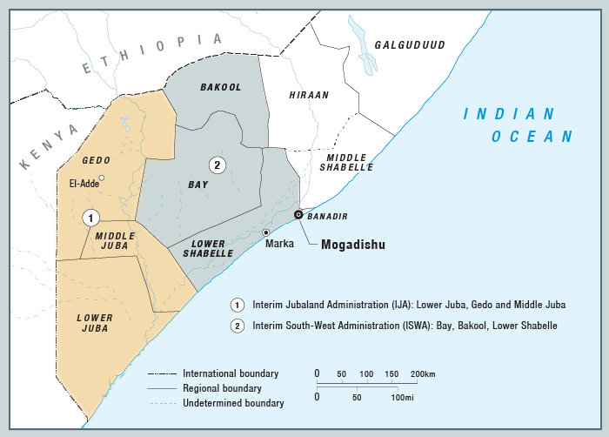

Slide 7
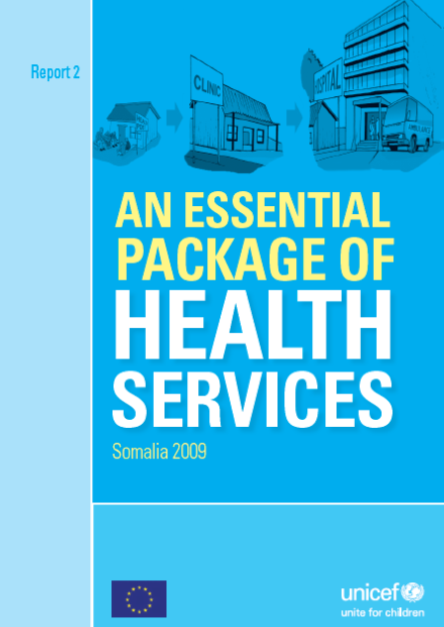
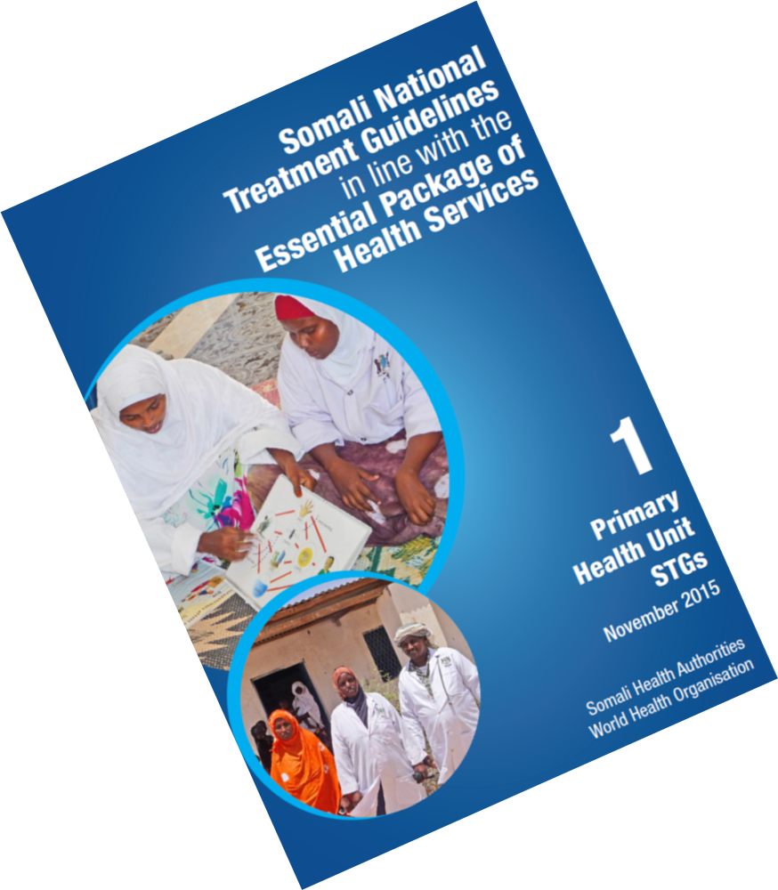
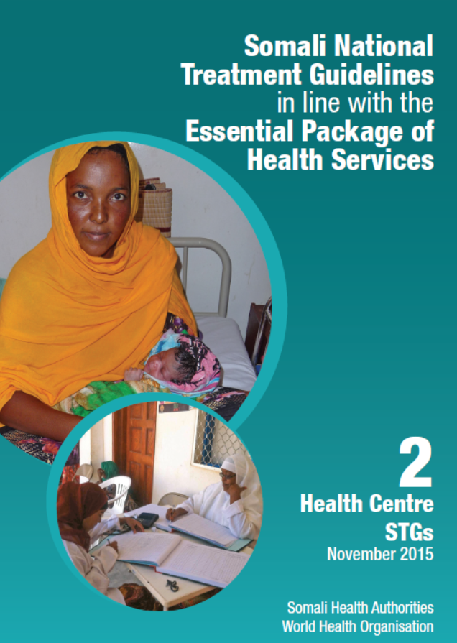
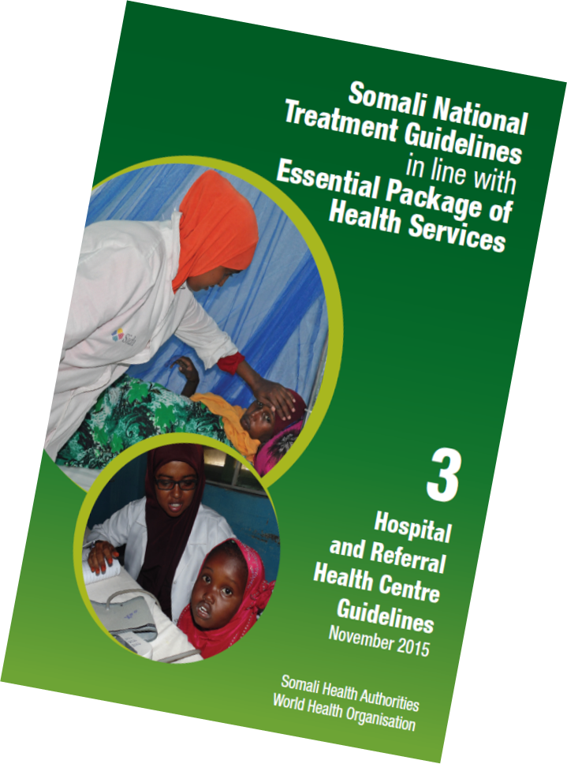
Somali National Treatment Guidelines
in line with EPHS

Slide 9
Need to think:
Cross border
Regionally
Follow the people
Describe the situation as it is – and find out what works
Access however it can be obtained
Opportunities as they arise
Innovate, flexible approaches

Slide 10
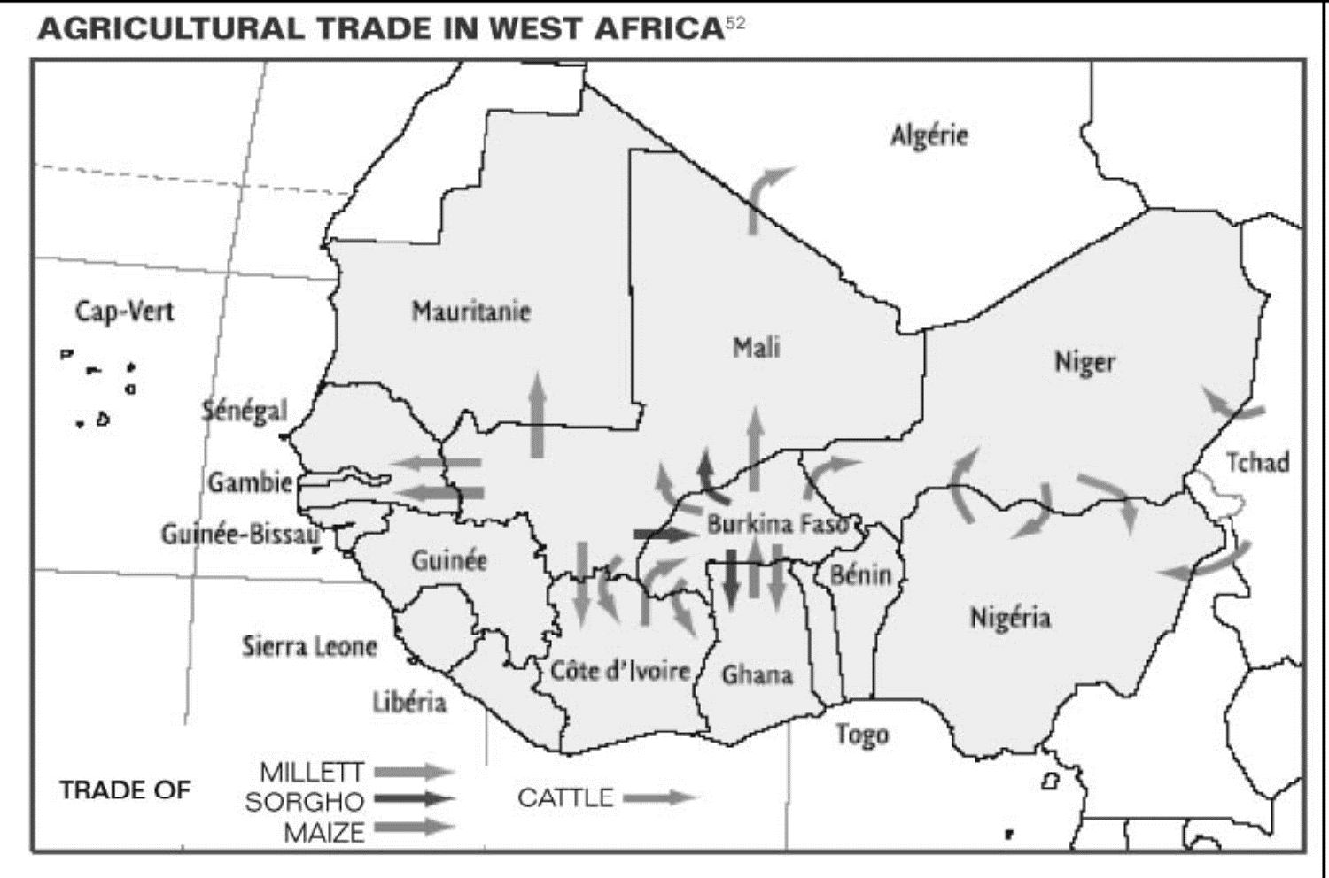
Food crisis in Niger 2004 – 2005 – « the world’s first free market famine»…..?

Slide 11
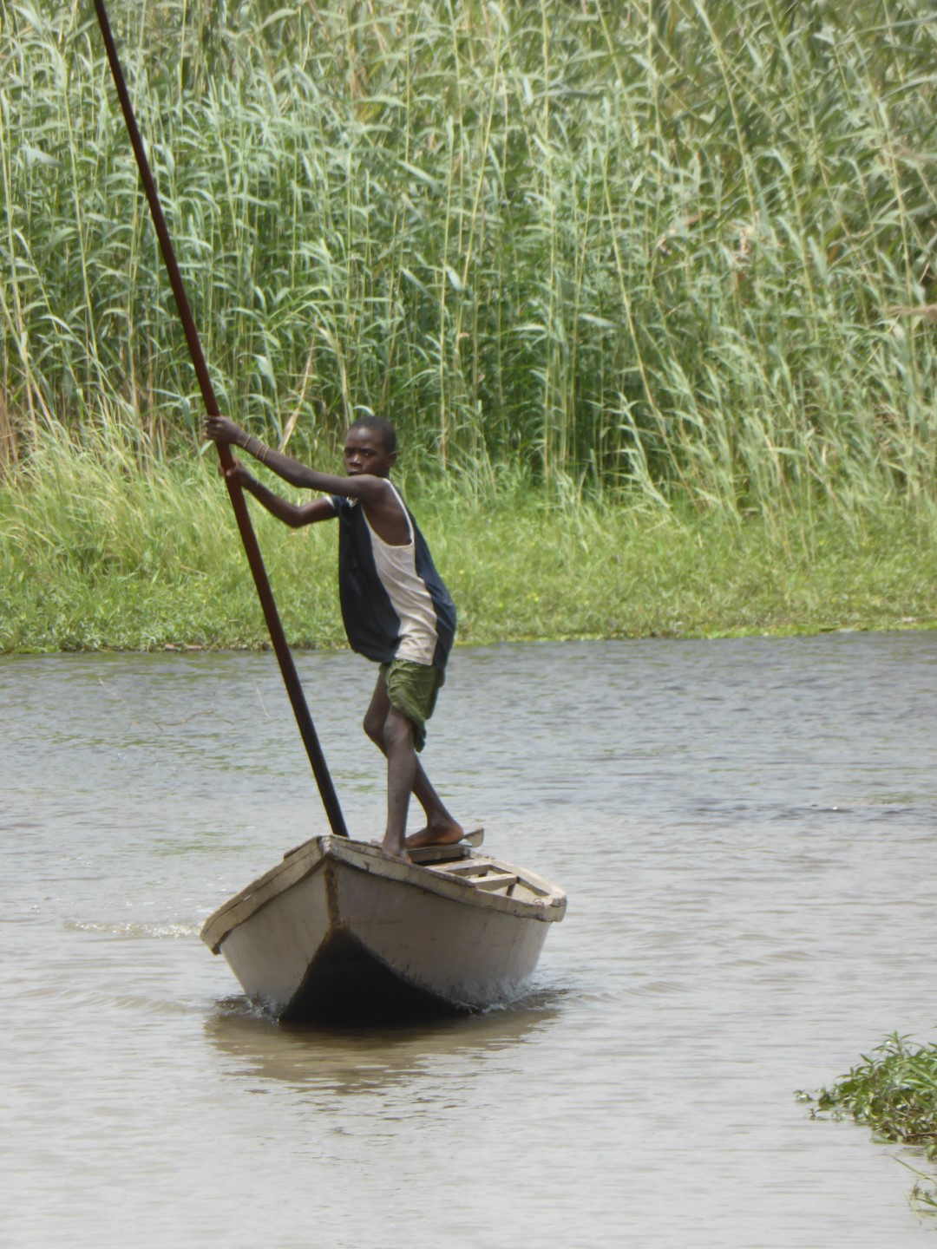

Slide 12
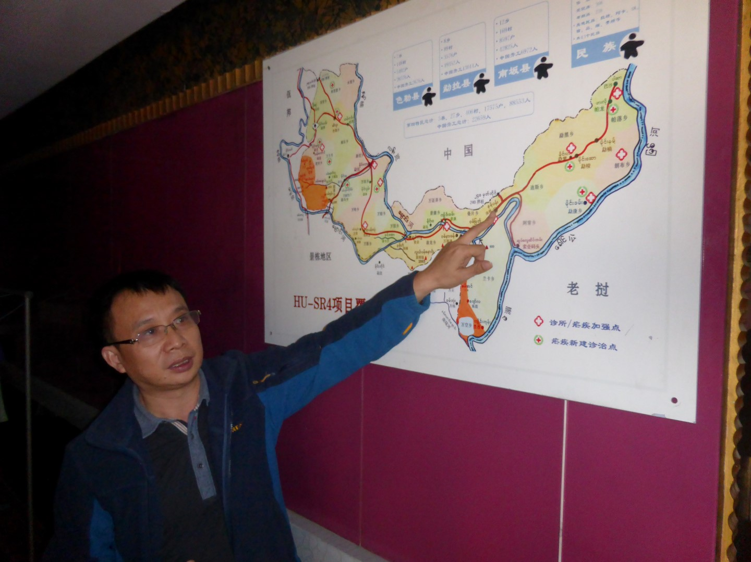

Slide 13
Approaching fragility
Which countries, parts of countries or regions experience extreme fragility?
Much higher risk to programmes – operational, security, travel
How to describe them? – use terms that can be used for parts of countries, for regions, in cross border interventions.

Slide 14
COUNTRY | POLITICAL | OPERATIONAL | SECURITY | TERRORISM | TRAVEL
COE countries (FSI 2013 countries 1 to 16 and acute instability)
Somalia | Extreme | Extreme | Extreme | High | Extreme
Congo (DRC) | High | High | High | Low | High
Sudan | High | High | Medium | Medium | Medium
South Sudan | High | Extreme | High | Low | High
Chad | High | High | Medium | Low | High
Yemen | High | High | High | High | High
Afghanistan | High | Extreme | Extreme | High | Extreme
Haiti | High | High | High | Low | High
Central African Republic | High | High | High | Low | High
Zimbabwe | High | High | High | Insignificant | Medium
Iraq | High | High | Extreme | Extreme | Extreme
Côte d'Ivoire | High | High | High | Low | High
Pakistan | Medium | High | High | High | High
Guinea | High | High | Medium | Low | Medium
Guinea-Bissau | High | High | Medium | Low | High
Nigeria | Medium | Medium | High | Medium | High
Syria | Extreme | Extreme | Extreme | High | Extreme
Egypt | High | Medium | Medium | Medium | Medium
Mali | High | High | Medium | High | Medium

Slide 15
COUNTRY | POLITICAL | OPERATIONAL | SECURITY | TERRORISM | TRAVEL
FSI 2013 countries 17 to 30
Kenya | Medium | Medium | Medium | Medium | Medium
Ethiopia | Medium | Medium | Medium | Medium | Medium
Burundi | Medium | High | Medium | Low | Medium
Uganda | Medium | Medium | Low | Medium | Medium
Liberia | Medium | High | Medium | Low | Medium
North Korea | High | Extreme | Low | Insignificant | Medium
Eritrea | High | High | Medium | Medium | Medium
Myanmar | High | High | Medium | Low | Medium
Cameroon | Medium | High | Medium | Low | Medium
Sri Lanka | Medium | Medium | Medium | Medium | Medium
Bangladesh | Medium | High | Medium | Medium | Medium
Nepal | High | High | Medium | Low | Medium
FSI 2013 countries 31 to 40
Mauritania | High | High | Medium | Medium | Medium
East Timor | Medium | Medium | Medium | Low | Medium
Sierra Leone | Medium | High | Medium | Low | Medium
Burkina Faso | Medium | Medium | Medium | Low | Medium
Congo | Medium | Medium | Medium | Insignificant | Medium
Iran | High | High | Low | Low | Low
Rwanda | Medium | Low | Low | Low | Low
Malawi | Medium | Medium | Low | Insignificant | Low
FSI 2013 countries 41 to 50
Cambodia | Medium | Medium | Medium | Medium | Medium
Togo | Medium | Medium | Medium | Low | Medium
Angola | Medium | High | Medium | Low | Medium
Uzbekistan | High | High | Medium | Medium | Low
Zambia | Medium | Medium | Medium | Insignificant | Low
Lebanon | Medium | Medium | Medium | Medium | Medium
Equatorial Guinea | High | High | Medium | Low | Low
Kyrgyzstan | High | High | High | Medium | Medium
Swaziland | Medium | Medium | Medium | Insignificant | Medium
Djibouti | Medium | Medium | Medium | Medium | Medium

Slide 16
Challenges
understanding the political economy
weak governance
poor access to services
limited resilience to natural hazards
conflict
lack of data, poor programme results
mass displacement

Slide 17
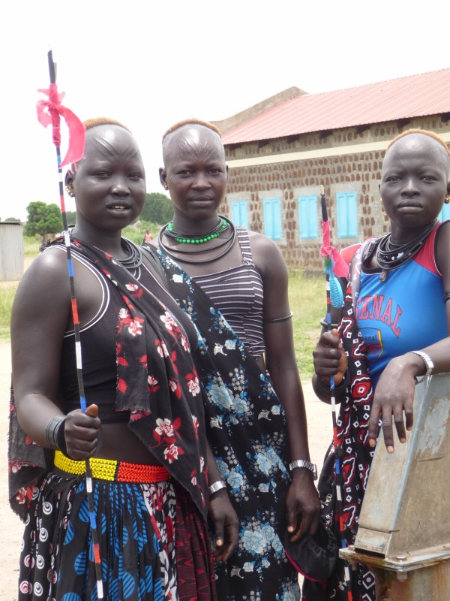
Assessments
Joint assessments: political economy, fragility & risk, PFM, health service delivery mapping
Quote of the week from South Sudan:
‘Not ethnic identity, but the politicisation of ethnicity and the militarisation of politics that has devastated the country’
Winnie Gulliver, South Sudan Action Network on Small Arms

Slide 18
Approaches to health system support
Tailor-made responses
Partnerships
National health strategy & essential health service package
Improved contracting models & adjustability – greater accountability for deliverables to health authorities and citizens.
Contingency planning permitting resource reallocation.
Greater leadership of & regulation by health authotities. Strengthen pay roll.
Enhanced risk management - fiduciary, programmatic, governance, health service risks
Investment in harmonised M&E, PFM, PSM, HRH
Interventions designed to overcome operational challenges; negotiating access.
TA needed for specific health system support
(+ work of development banks, OECD DAC principles of engagement, INCAF, New Deal, IHP+ Seven Behaviours….)

Slide 19
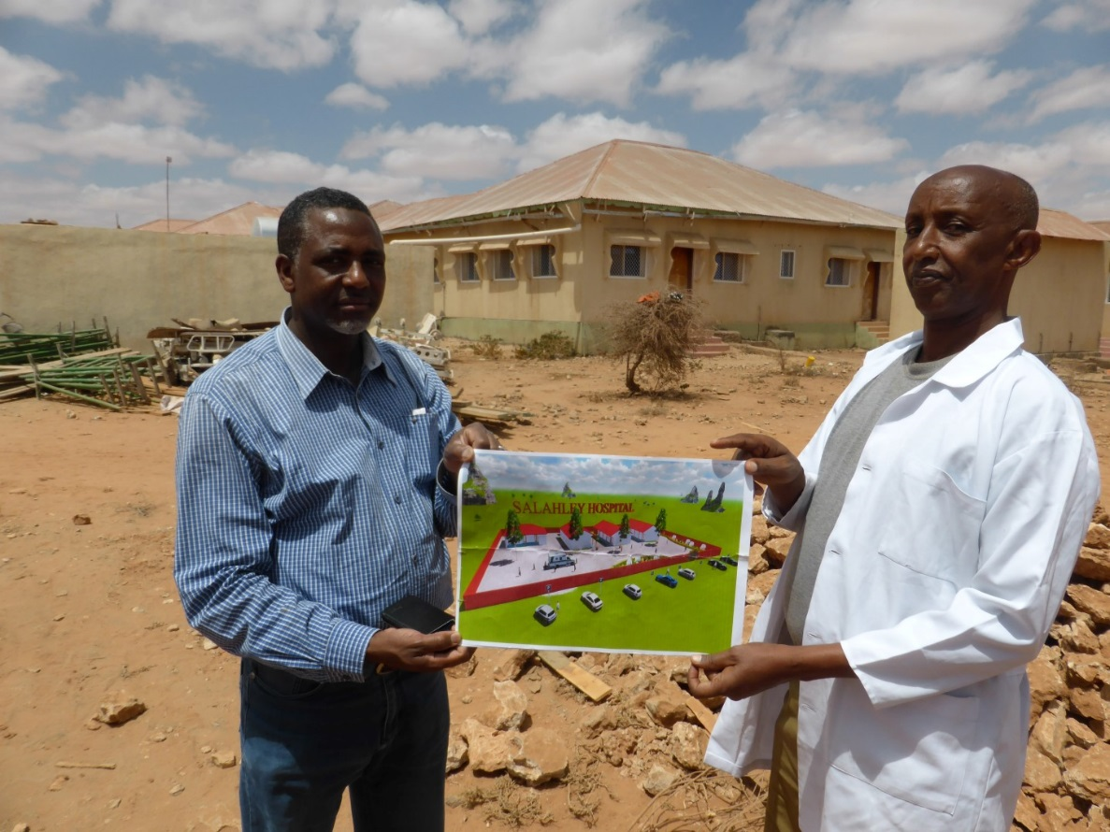
UHC in countries in challenging operating envrionments…..?
Start with an essential package, or at least MNCH & 3 diseases
Advocate for core services to be free
Commitment of external partners to finance these
Diversify potential revenue sources
Advocate for increasing resources from central and local government
Data, results & VfM

Slide 20
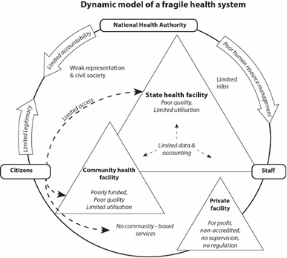
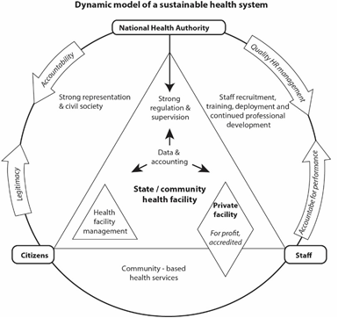
Health system design

Slide 21
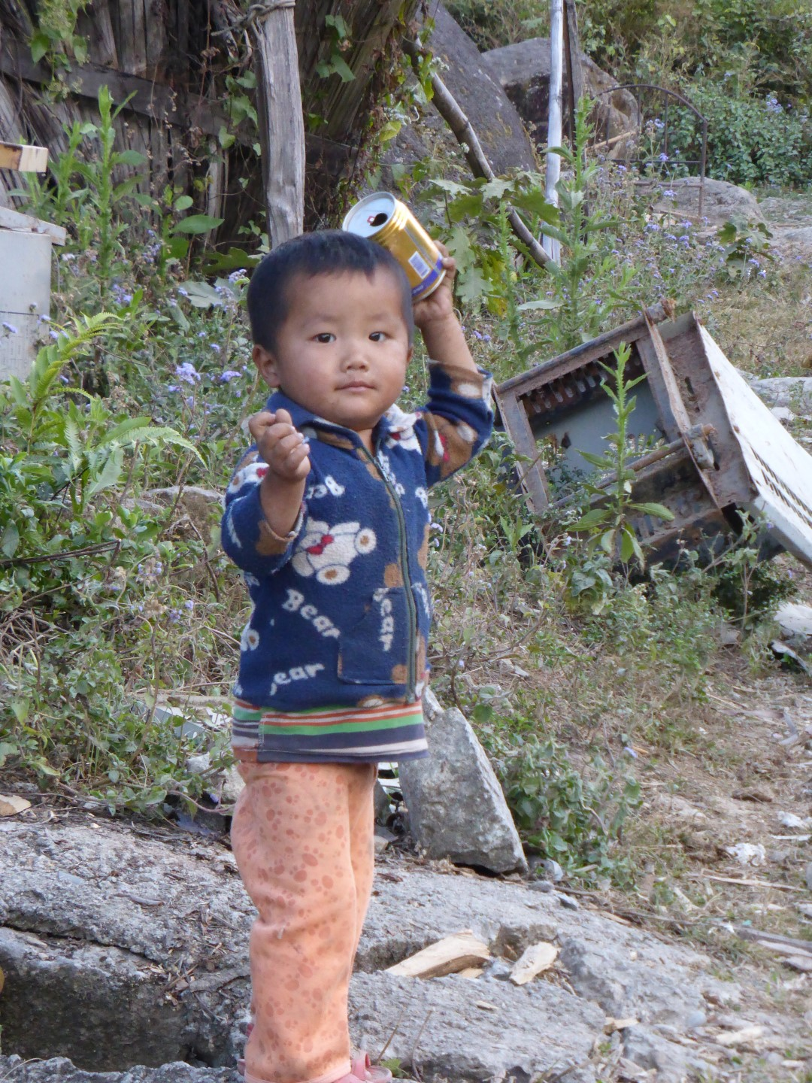
DINAMISM
Diversified Income
National Authority(ies)
Multiple ownership
Innovation
Social accountability
Market-oriented

Slide 22
Designing programmes for positive impact on state building
Support leadership & progressive financial contribution
Focus support for inclusive provision
Decentralise resources, with accountability to local communities
Ownership – central, regional, local
Build sub-national capacity & support public reasoning & consent building - may contribute to political agency
For legitimacy, quality of provision more important than who provides (non-state partners can be perceived to be ‘arms of the state’)
Corruption & weak PFM undermine legitimacy

Slide 23
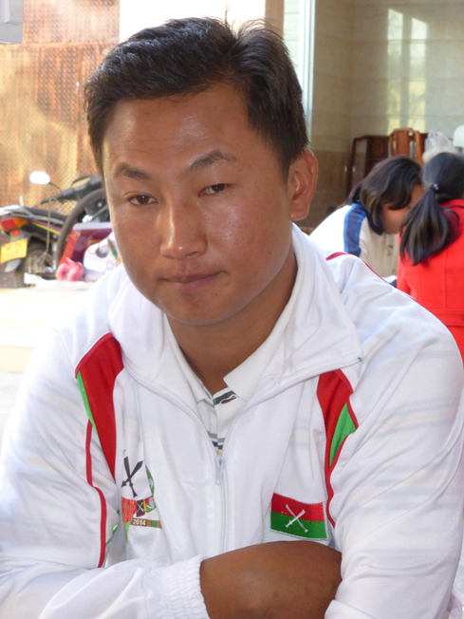
Statebuilding potential of health programming in Myanmar special regions
promote social accountability
initiatives to bring authorities that are in conflict together
support UHC & health rights
support all efforts to demilitarise the special regions and help people seek opportunities
advocate that resources are used for services

Slide 24
Health Pooled Fund, South Sudan Logframe indicators for accountability & inclusion:
% of state MoH and County Health Departments publish their budgets
numbers (%) of active health facility committee meetings
% health facility committee are women
% monthly supervisions of CHDs & facilities conducted to agreed standard by State MoH team
% staff in supported facilities paid by SMoH in full and on time

Slide 25
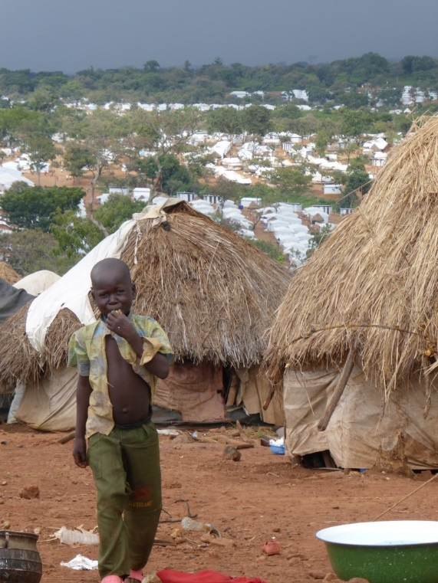
Refugees, diplaced & migrants
Inclusion in national planning
Flexible programme design ‘follow the people not the border’

Slide 26
Sources
Orbis: The Stanford Geospatial Network Model of the Roman World. Map of the Roman world was created by Walter Scheidel, an historian in the Classics and History Departments at Stanford http://orbis.stanford.edu/
http://reliefweb.int/report/nigeria/lake-chad-basin-crisis-overview-12-may-2016
Essential Package of Heatlh Services. Somali Health Ministries. EC. UNICEF. 2009 http://www.unicef.org/somalia/health_11681.htm
“Drought and vulnerability in the Sahel region of West Africa – Review of drought interventions with special focus on malnutrition and Drought preparedness response” http://ec.europa.eu/echo/pdf_files/evaluation/2007/west_africa_sahel.pdf
Oakland Institute, “Sahel: a prisoner of starvation? A case study of the 2005 food crisis in Niger”, who blame it on the opening up of the market of the 16 ECOWAS countries
Commins, Stephen, Fiona Davies, Anthea Gordon, Elizabeth Hodson, Jacob Hughes, and Stephen Lister. 2013. Pooled funding to support service delivery – lessons of experience from fragile and conflict-affected states. 87 p. Department for International Development, DFID. Available from: http://r4d.dfid.gov.uk/pdf/outputs/misc_Gov/61050-PFs-Full_Volume(May2013).pdf
Pearson N et al. Thematic review of the Global Fund in fragile states. Global Fund, EHG. KIT 2014 file:///C:/Users/User/Downloads/TERG_Evaluation2013-2014ThematicReviewFragileStates_Report_en.pdf
Pearson N. 2010 . The Role of the Health Sector in Wider State-Building; a discussion paper. Save the Children, Health & Fragile States Network 2010
Su. A. . Splits and schisms in South Sudan. How the creation of more states is undermining peace. Irin 16 June 2016 https://www.irinnews.org/analysis/2016/06/16/splits-and-schisms-south-sudan
Pearson N. Emerging helath brief: Health systems in fragile states. Global Health Minders. University of Copenhagen
Ndarahutse S et al 2012 Synthesis Research Report. State-building, Peace-building and Service Delivery in Fragile and Conflict-affected States. CfBT, Practical Action, Save the Children 2012 http://r4d.dfid.gov.uk/pdf/outputs/misc_gov/60963-Final_synthesis_report_service_delivery_and_state_legitimacy_26Nov2012.pdf
DFID 2011 Business Case and Intervention Summary. South Sudan Health Pooled Fund http://iati.dfid.gov.uk/iati_documents/3769141.doc
UNHCR Global health strategy for Public Health. 2014 – 2018. http://www.unhcr.org/530f12d26.pdf
UNHCR Policy on alternatives to camps. 2014 http://www.unhcr.org/5422b8f09.pdf

Slide 27
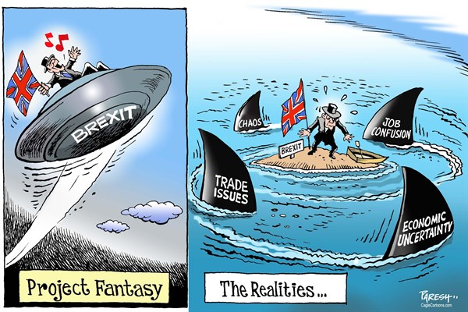
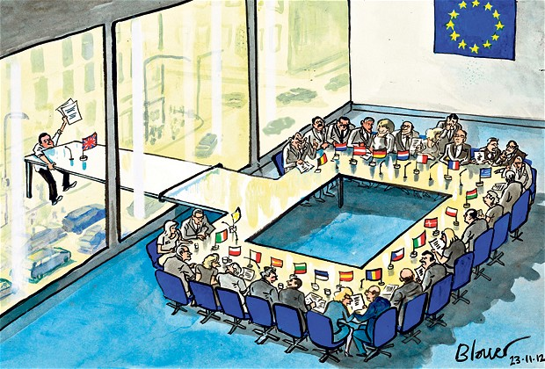

Slide 28
Approaches to development cooperation for effective health system support in conflict affected/ fragile settings
IHP+. UHC2030 23rd June 2016
Nigel Pearson

