Slide 1

Third face-to-face meeting of the UHC2030 working group on sustainability and transition from external funding
28th January 2019, Bangkok Thailand

Slide 2
Milestones
First WG Meeting 2017
Country consultation
Second WG Meeting 2017
Draft Statement presentation to UHC2030 Committee
Launch of the Statement 2018
Initiation of the WG
Transition timelines and fiscal space indicators
Meeting with health programs and donors
Mapping of policies

Slide 3
Universal health coverage, leaving nobody behind.
Increase effective coverage.
National ownership and good governance.
Strengthen national institutions.
Health system perspective.
Adequate domestic resources.
Improve the way resources are used
HSS + disease specific programs. Coordinated national transition plans.
Consistency and synergies.
National
ownership
National
ownership
Working
together
Results
Efficiency
Working
together
Efficiency
The Statement

Slide 4
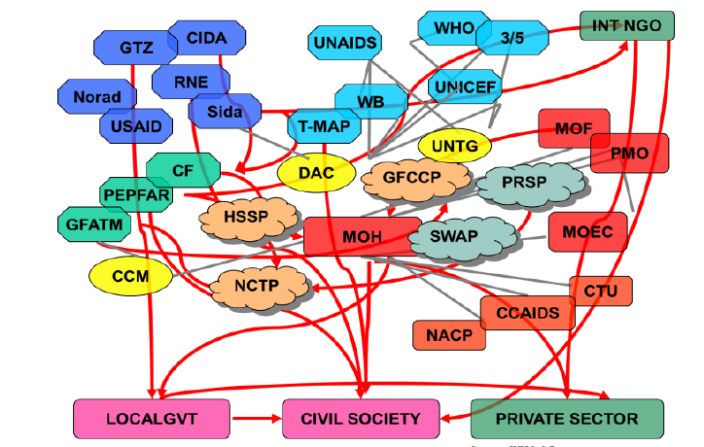

Slide 5
What can the Statement achieve?
Reflect common understanding
Capture consensus areas
“Who could be in disagreement?”
Provide general orientation
    “Are we on the right path?”
Point to concrete action
    “What should we do?”

Slide 6
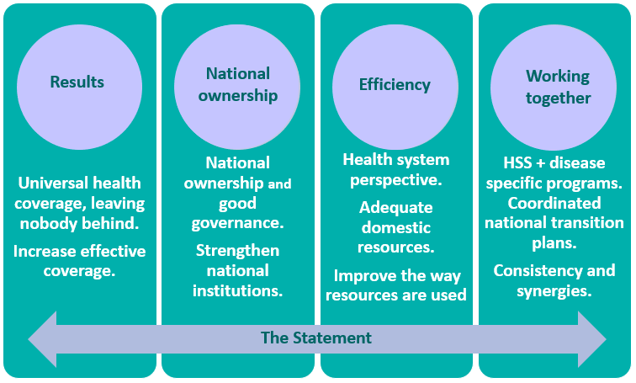
How to trigger action?

Slide 7
Objective: Build consensus on a collaborative agenda to operationalize the Statement´s principles
Operationalizing the statement
2. Program perspectives and a country lens: December 10th meeting
3. The 10 principles: what action is needed and by whom?
4. Feed back and implication for action

Slide 8


2)
Instituto de Análisis y Gestión
Lima, 21 de enero de 2018

