Slide 1
Costs and benefits of fragmented financial management arrangements for donor-financed projects in the health sector
Presented By: Maxwell Dapaah,
Senior Financial Management Specialist, World Bank Group

Slide 2
Why PFM in health ?
An open and orderly PFM system enables desirable results in sectors, including health.
Progress towards UHC requires reliance on government spending, and for some countries reliance on donor funding bringing PFM to the forefront:
how budgets are formed and allocated to different ministries (including health),
how these funds flow through different levels of administration, and
how these budgets are implemented and/or how donor projects are implemented
Reliance on country PFM system helps to minimize use of parallel arrangements for implementing donor projects.
If reliance on country systems is not feasible harmonization among DPs will help minimize fragmentation and associated high transaction cost
Notes:
KEY FOR THIS WORK: how these budgets are implemented and/or how donor projects are implemented – key for countries that receive a significant amount of aid --- IHP+ partner countries

Slide 3
Problem definition & aim of study
Development partners have often advanced financial management risk as one of the main reasons for not using country systems or for not harmonizing.
As part of a larger PFM in health study, a review was conducted to analyze data on specific FM cost items from four development partners to help determine the costs and benefits of fragmented donor FM arrangements in the health sector.
The study aims to provide an evidence-based approach for determining the costs and benefits of parallel FM arrangements for donor-financed projects.

Slide 4
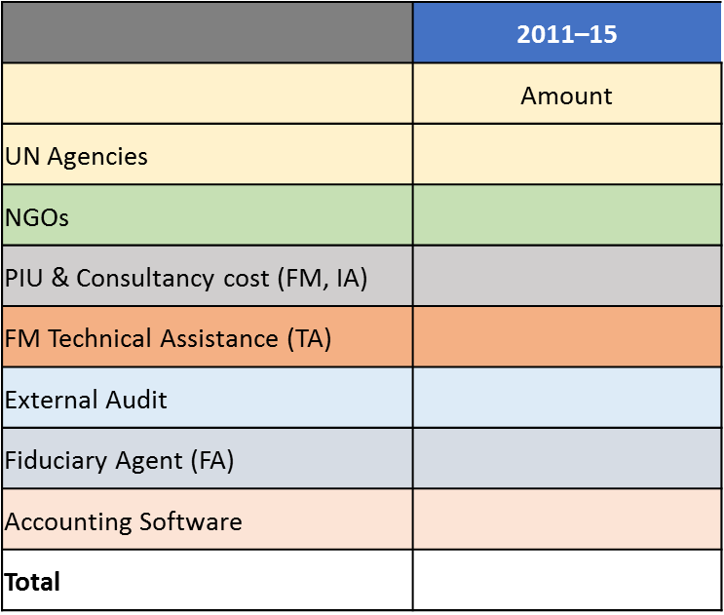
Aim of study and problem definition
Aim of study and problem definition
Parallel Arrangements cost items
The study aims to provide an evidence-based approach for determining the costs and benefits of parallel FM arrangements for donor-financed projects
Development partners have often advanced financial management risk as one of the main reasons for not using country systems or for not harmonizing.
As a part of the larger PFM in health study, a review was conducted to analyze data on specific FM cost items from four development partners to help determine the costs and benefits of fragmented donor FM arrangements in the health sector.

Slide 5
Hypothesis
Where a country has strong PFM systems, the incremental cost that results from reliance on country PFM systems will be less than the aggregate cost of each donor having separate FM arrangements
Where a country has weak PFM systems, the aggregate cost of harmonized implementation arrangements among donors will be less than the cost of having separate FM arrangements

Slide 6
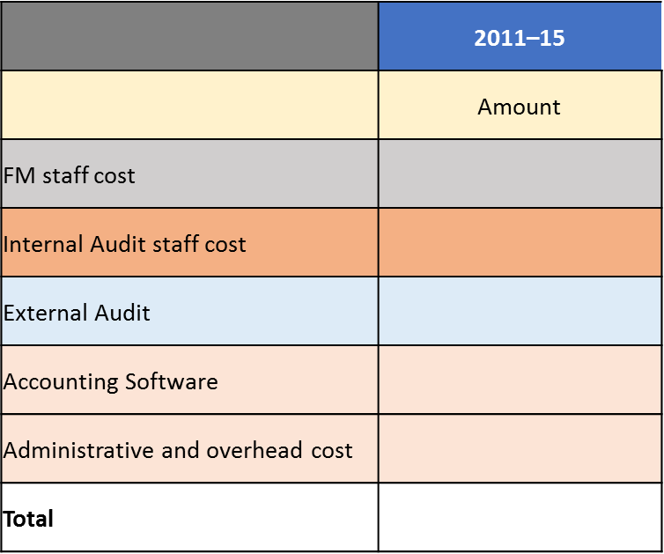
Methodology
Country case studies
Cost elements
The incremental cost of use of country systems- if it is determined based on independently assessed fiduciary risk profile of the country and health sector FM arrangements that such systems could have been used for implementing the donor financed project; or
The cost of harmonization among DPs - if it is determined in that country FM systems are weak and DPs will not rely on such systems but could collaborate to use common implementation arrangements that either partially rely on country systems, or are stand-alone.
Compare either cost to the cost of parallel FM arrangements obtained from DPs per country
Consolidate all the cost data from the three steps above
IHP+ principles on FM harmonization and alignment

Slide 7
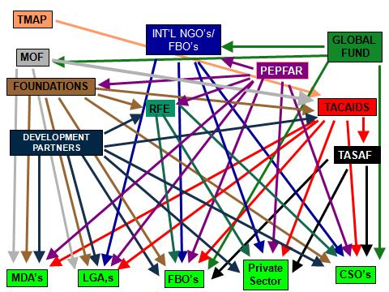
Counting the cost of Fragmentation
Fund flow and reporting relationships are inherently complex in the health sector.
But the addition of a plethora of FM arrangements for donor funding increases the complexity.

Slide 8
KENYA: Cost of parallel arrangements vs cost of harmonization
The analysis proposes a hypothetical scenario that assumes the use of harmonized arrangements agreed upon by the development partners in cases where the risks in the financial management systems could not be mitigated in the short run, along with the use of country systems in cases where the residual risk is low.
Hybrid arrangements would have costed US$5.5 million, compared to the total cost of US$28.8 million that the four DPs surveyed incurred over the study period.
Hybrid arrangement cost is approximately 1 percent of the total disbursed by the four donors over the study period.
Notes:
Country systems used:
FM staff
FMIS – rollout to remaining counties
Not used
SAI
Internal audit

Slide 9
Findings: Kenya Country case
Cost of fragmentation involving 4 DPs
Cost of harmonized FM arrangements
Year | Fiduciary agent (FA) | NGO | PIU | UN agency | Total
2011 | 0 | 0.63 | 0.41 | 0 | 1.04
2012 | 0.52 | 3.01 | 0.36 | 0 | 3.89
2013 | 0.72 | 3.71 | 0.52 | 0.47 | 5.42
2014 | 0.22 | 7.44 | 0.56 | 0.09 | 8.31
2015 | 1.78 | 6.88 | 0.31 | 1.18 | 10.15
Total | 3.24 | 21.67 | 2.16 | 1.74 | 28.81
 | 2011–15
 | Amount
FM staff cost | 2.0
Internal Audit staff cost | 0.5
External Audit | 0.6
Accounting Software | 1.3
Administrative and overhead cost | 0.4
Coordination cost | 0.8
Total | 5.50

Slide 10
Analysis
Cost of parallel arrangements in the Sector, 2011–15
Analysis
Financial management cost of using such parallel arrangements was US$28.8 million between 2011 and 2015 and beyond. This compares with a total disbursed amount of US$582.4 for project/program implementation
the total cost of parallel arrangements was therefore 5 percent of the total amount disbursed over the study period
majority of the cost of parallel implementation arrangements is associated with the use of NGOs (US$21.7 million), followed by the use of fiduciary agents (US$1.8 million),
This implies that over time, increases in donor contributions to the sector would result in an exponential increase in costs associated with FM arrangements if NGO’s systems continue to be used.
This ceases to become sustainable as the administrative costs and inefficiencies associated with managing several different NGO’s to handle several donor projects becomes high.

Slide 11
Synthesis of cost for four DPs in 63 countries
Cost of Parallel Implementation as Percentage of Total Disbursement by Development Partner and Year, 2011–15
Pattern of Cost of Parallel Implementation Arrangement (US$ millions), 2011–15
Period | World Bank | Global Fund | GAVI | KfW | All agencies
2011 | 13.40 | 5.00 | 16.30 | 3.10 | 37.80
2012 | 19.60 | 9.50 | 44.20 | 5.10 | 78.30
2013 | 19.60 | 171.30 | 132.10 | 7.10 | 330.10
2014 | 17.30 | 196.80 | 79.00 | 10.00 | 303.10
2015 | 72.40 | 224.90 | 108.40 | 15.00 | 420.70
Total | 142.30 | 607.50 | 380.00 | 40.30 | 1,170.00

Slide 12
SYNTHESIS: Cost breakdown by parallel arrangement
Pattern of Cost of Parallel Implementation Arrangements by Cost Element
Breakdown of Total Cost of Parallel Implementation Arrangements by Cost Element (in US$ millions)
Cost Driver | 2011–15
 | Amount | Percent
UN Agencies | 510.6 | 44
NGOs | 258.7 | 22
PIU & Consultancy cost (FM, IA) | 233 | 20
FM Technical Assistance (TA) | 88.6 | 7
External Audit | 54.2 | 5
Fiduciary Agent (FA) | 23.8 | 2
Accounting Software | 1 | 0
Total | 1,170.00 | 100%

Slide 13
Findings: DP contributions to cost of parallel arrangements
Development Partner Contributions to Each Cost Element (US$ millions)
Development Partners’ Contributions to Total Cost of Parallel Implementation Arrangements

Slide 14
Findings: Cost pattern by regions and disbursement
Pattern of All Development Partners’ Contributions to Total Cost of Parallel Implementation Arrangements by Region
Total Cost and Disbursement of Parallel Implementation by Development Partner and Year, 2011–15 (in US$ millions)
 | GAVI, World Bank, KfW & Global Fund
 | 2011 | 2012 | 2013 | 2014 | 2015 | Total
Total FM-related cost of parallel implementation arrangements provided by participating DPs | 37.8 | 78.3 | 330.1 | 303.1 | 127.57 | 876.8
Total disbursement of health project-type disbursement obtained from OECD Creditor Reporting system | 2,226.0 | 2,753.4 | 3,675.4 | 3,155.7 | 2,153.9 | 13,964.4
Cost as percentage of disbursement | 2% | 3% | 9% | 10% | 6% | 6%

Slide 15
Conclusions
UN agencies (44 per cent) and NGOs (22 per cent) are the most common parallel arrangements used
Continued reliance on parallel arrangements may have contributed to a ‘substitution effect’
Low spending on automation of accounting record-keeping and on external audit, when compared with the weaknesses in the control environment and of supreme audit institutions (SAIs) in the countries surveyed implies that project funds are at high risk of misuse
Misuse might not be detected early, if at all, during implementation.
the high spending on parallel arrangements may not necessarily be an adequate safeguard against fiduciary risks, so long as key aspects of the control environment fail to be consistently prioritized
Notes:
Although reliance on UN agencies and NGOs may be needed under certain circumstances (such as during emergencies and fragile situations), these findings show that in countries that meet neither of these criteria, continued reliance on parallel arrangements may have contributed to a ‘substitution effect,’ whereby DPs incur higher costs to establish or even strengthen parallel arrangements and expend less effort and costs to strengthen and use country systems because they consider them to be weak.

