Slide 1
Paper on ‘Health Systems Strengthening for UHC: Building a shared vision’
UHC2030: working together to strengthen health systems
12th-13th December 2016, Geneva

Slide 2
Purpose of the Paper
This paper outlines a common framework for UHC2030 constituencies and provides key policy entry points for promoting UHC. The Paper will be considered a consensual key reference document for the UHC2030, while also serving as a broader reference for collaboration on the HSS and UHC agenda.
Preventing duplication and fragmentation of initiatives, this paper will play a significant role to feed into the current arrangement of UHC 2030 operationalized in 2017.

Slide 3
Background
Since September 2015, several Global and Regional initiatives have been developed to harmonize health systems strengthening for UHC
It was felt that a consensus framework is needed to further align these initiatives.
In 2015, the government of Germany, as the presidency of G7 launched the roadmap process "Healthy Systems – Healthy Lives" to harmonize health system strengthening
The government of Japan, as the presidency of G7 in 2016, announced the G7 Ise-Shima Vision for Global Health , which politically endorsed the key principles of UHC 2030.
In the Nairobi Declaration of the sixth Tokyo International Conference on African Development (TICAD VI) , African countries and their development partners endorsed UHC in Africa: A framework for Action to advance UHC in African region .
More Global and Regional initiatives are expected to launch in coming years.

Slide 4
"Consensus Paper"
Representatives of the Governments of Japan, Germany, the World Bank, the WHO and the EC elaborated a consensus in November 2016 on the essential contents of this paper, comprising three sections:
1. A shared commitment to established principles
2. Performance goals and policy entry points to promote UHC through effective HSS
3. Critical components for the way forward

Slide 5
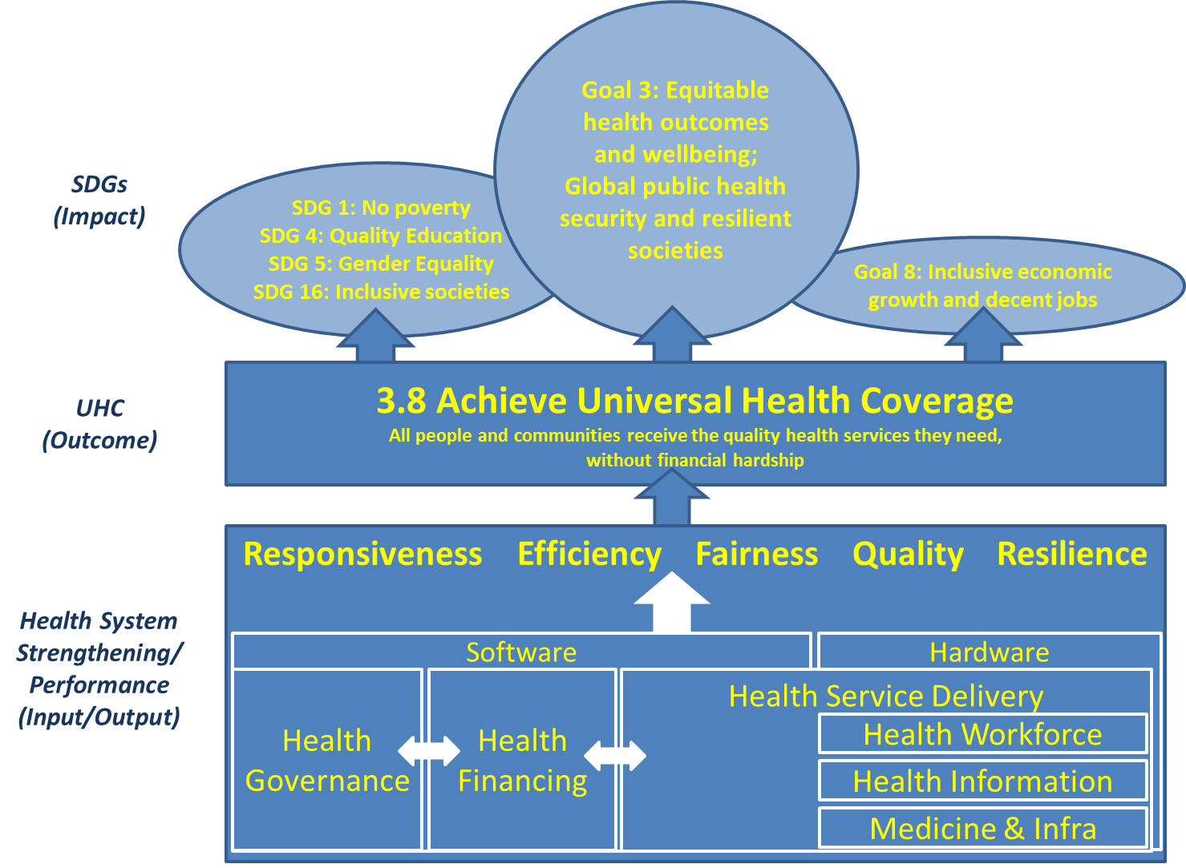

Slide 6
Fairness in access and financing
Quality
Responsiv-eness
Efficiency
Resilience
Service Delivery
Health Finance
Governance

Slide 7
Performance goals for effective HSS
Effective HSS to promote UHC requires clarity and consensus on both desired performance goals and policy entry points.
Five dimensions of health system performance should be the focus on HSS:
(i) Fairness in access and financing;
(ii) Quality;
(iii) Responsiveness;
(iv) Efficiency; and
(v) Resilience.

Slide 8
Policy entry points for HSS to promote UHC
HSS towards improved health system performance requires country and global action in three interrelated policy areas:
(i) Service delivery,
(ii) Financing and
(iii) Governance.

Slide 9
Service delivery
Service delivery as primary interface between the health system and the population
Need to prioritize primary health care and frontline services
  Scale up front-line health workers and strengthe supportive functions
  Organizational innovations
Focus on healthcare quality and patient safety

Slide 10
Health financing
Domestic resource mobilization is key for progress towards UHC
DAH should complement domestic financing more effectively
Expanding pooling arrangements Is essential to improve financial protection
Efficiency gains are critical to improve resource mobilization and health system performance

Slide 11
Governance
Good governance is a critical foundation of all health systems
UHC will require new partnerships and opportunities for dialogue, including non-state actors
Strengthen platforms for effective intersectoral actions
Strengthen capacity for applied policy research and evaluation
Collective action across countries – medical research, norms and standards, communicable disease control

Slide 12
Moving Forward
Leaving no one behind – a commitment to equity, transparency and a rights-based approach
Strengthening health systems based on national strategies and leadership
Making health systems everybody’s business – participatory platforms, private sector as key stakeholder, active participation of civil society
Using data and evidence for better health
Making development assistance more effective

Slide 13
Next Steps
Jan 13: Draft sent to UHC2030 Steering Committee, signatories, constituencies, WHO regions and stakeholders
Feb 3: Feedback from the above
Feb 28: G20 health experts discuss paper
Apr 21: WBG spring meeting side event (?)
May 20: G20 Health Ministers + partners launch paper
May 22: WHA side event

