Slide 1
IHP for UHC 2030 Consultation
June 23, 2016

Slide 2
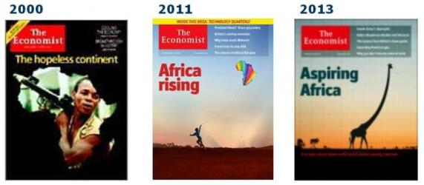
Unprecedented Economic Growth
World per capita GDP
1990 dollars
Maddison
DeLong
Source: J. Bradford DeLong, Estimates of World GDP, One Million B.C. – Present, 1998
Notes:
Equally important but less appreciated is an unprecedented expansion of GDP in less developed nations
Driven by better governance, trade, new technology, as well as the demographic dividend
Africa, considered a hopeless coninent a decade ago by the economist, it is now the continent growing fastest in the world

Slide 3
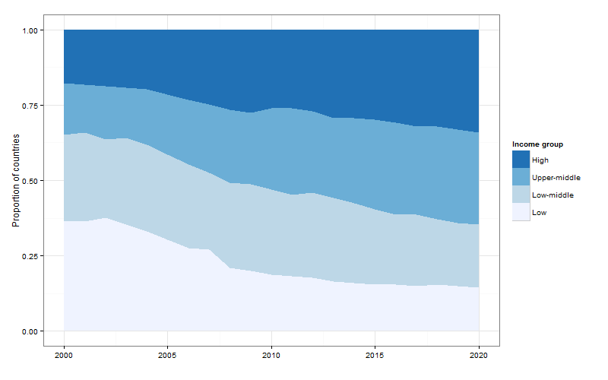
Half the LICs in 2000 moved up
Source: WHO, 2012

Slide 4
“The First Law of Health Economics”
Log Total Health Expenditures/Capita
N = 178
R2 = 94%
Source: Jacques van der Gaag; WHO/IMF 2004
Notes:
As developing countries grow, they will inevitably spend more on health
Health spending WILL go up.
Jacques Van Der Gaag studied 178 countries and found that health spending increased disproportionally with increases in GDP (income elasticity >1)
USAID examined data for 65 countries which carried out own health accounts (rather than use modeled data). We also found that THE rises slightly faster than GDP.

Slide 5
Economic growth can bring some challenges: e.g. the OOP ditch
Source: WHO 2011 data based on World Bank Country Income Groupings
Notes:
Total health expenditure grows as countries transition from low to middle income status
But as ODA gets diluted or withdrawn, public expending fails to fill in and societies meet demand paying OOP which inefficient and regressive
(with catastrophic health expenditures hitting 150 million people a year and becoming a leading cause of impoverishment – 3-4% of households)
We must avoid this predictable financial “ditch”, anticipating not only the percent of budget that goes to the health sector,
but creating systems that promoted pre-paid, risk pooled financing (either NHS or mixed insurance schemes)

Slide 6
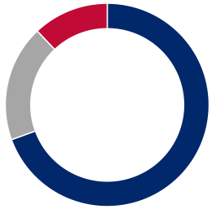
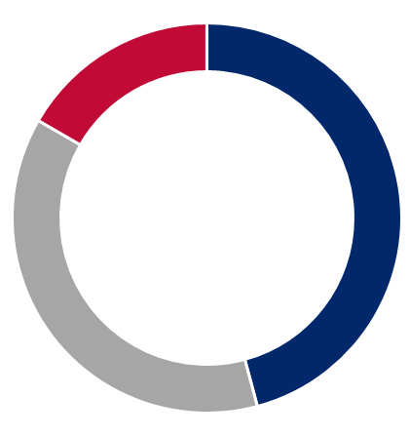
USAID vision for health financing
DONOR DEPENDENCE
Traditional: Development assistance for health surpassed $31 billion in 2013; much of this assistance is in the form of grants, upon which many LMICs are dependent
Decrease
donor dependence
Transitional: Donors gradually sunset grants, increase the use of financing instruments to facilitate country-led transition to more sustainable health budgets, and reserve grant-based aid for global public goods and the last mile
Reduce
out-of-pocket spend
Increase domestic
resource mobilization
DOMESTIC POOLED EXPENDITURES
Traditional: Many LMICs spend less than 15 to 30% of their government budget on health (Abuja Declaration target); many opportunities for private sector mobilization go unrealized
TRADITIONAL
(TODAY)
Transitional: Through taxation and transparency programs, budget allocation efforts, and private sector mobilization, domestic public and private sectors increasingly replace donor funding
TRANSITIONAL
OUT-OF-POCKET EXPENDITURES (OOP)
Traditional: Out-of-pocket spending makes up over 40% of average total health expenditure in low-income countries, putting the poorest at risk of health-related financial catastrophes
SUSTAINABLE
(2035 AND BEYOND)
Transitional: Transitional support plans should ensure that out-of-pocket spending decreases to less than 20% of total health expenditure (e.g., through universal health coverage)
Source: IHME (2013): “Financing For Global Health 2013;”WHO (2011): “The Abuja Declaration;” WHO (2014): “Global Health Expenditure Database; WHO (2006): “Exploring the thresholds of health expenditure for protection against financial risk;” Dalberg analysis.

Slide 7
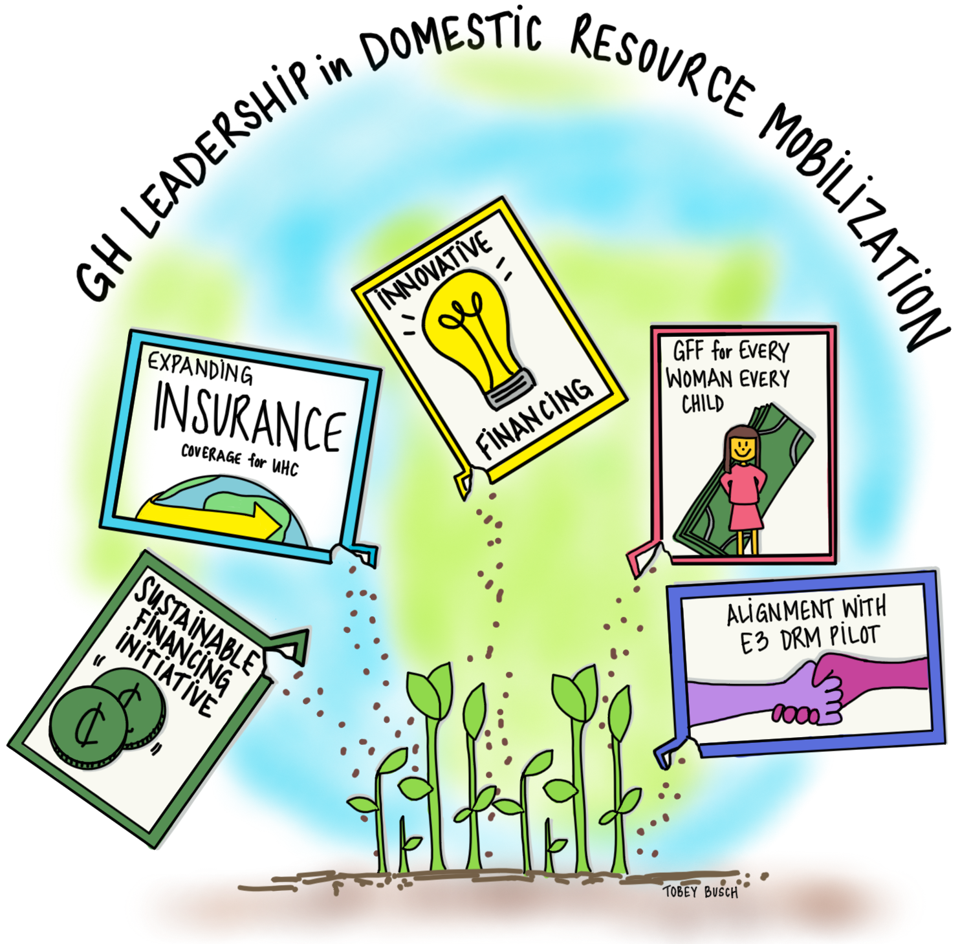
Notes:
Working with other USG, the World Bank, WHO, other agencies and most importantly countries. Focus not just on more domestic resources for health but on ensuring these target those most in needs and emphasize services that yield the greatest health benefits
Sustainable Financing Initiative in Kenya, Tanzania, Vietnam, Uganda, Mozambique, Nigeria and Zambia focuses on advocacy, efficiency, innovative financing, tax administration and policy. Early results -- Kenya mobilized $24 million with goal of $30-$40 million/year; Vietnam supported procuring ARVs at lower than global prices and expansion of SHI to include HIV/AIDs. NPV of additional resources mobilized will exceed a billion dollars
Global Financing Facility for Every Woman Every Child (GFF). USAID has partnered with the World Bank Group, the governments of Japan, Norway and Canada and B&MGF. Grant funds through ODA are blended with concessional loans to increase public financing for health, with longer term plans to mobilize revenues and promote universal access to basic health services. DRC has increased domestic resources for health from 4 to 7.5 percent of the national budget and for the first time allocated $3.5 million for contraceptives.
Expanding health insurance: We have helped countries design and implement both community (Ethiopia and Senegal) and social (Ghana and Kenya) health insurance programs as a means to achieve Universal Health Coverage (UHC), reduce the burden of OOP and increase access to services for the poor and those most in need
Innovative Financing: Blended financing mechanisms and guarantees can leverage private financing to support our objectives. In India investment of $31,000 through a DCA unlocked $9m of bank capital to scale up primary care network of clinics. The India Development Impact Bonds for maternal and newborn survival is the first DIB to be launched to address global health. Community Pharmacy Capital Fund in South Africa can improve access to essential, high quality, affordable medicines in areas with high unmet need using independent pharmacies

Slide 8
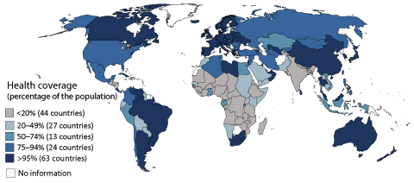
Universal Health Coverage:
The Ultimate Frontier for Global Health
Source: ILO 2014; OECD.
Notes:
Mention 50+50+50, Ghana and Rwanda, and then Thailand and Indonesia
We’ve constructed this map , the first of its kind, based on a recent report by the International Labor Organization (which defined coverage as the population “formally” covered by social health protection – explaining the US and South African rank)
Universal health coverage, the hallmark of a well-functioning health system,
Is the right aspiration on human rights and economic grounds
It is feasible: there are nearly 50 countries in the world with UHC today
And it is a measurable indicator of progress in health systems strengthening
But in Africa and Asia, where most poor people live, most countries don’t have UHC (or we can’t even tell)
Yet, it is happening already, from Mexico to Thailand, budding in Ghana, Rwanda and Vietnam, and even China and India.
We believe THS efforts, directly or indirectly, will help fill in blue several countries by next decade
We also believe making health systems visible and more appealing will facilitate the promotion of this agenda
51 countries (or 46.3%) of 110 countries the ILO has data for have formal UHC (>95%).
1 Low-Income (LI) Country (equal to 0.9% of the total and 4% of the LI group). Countries in this group with UHC: Gambia.
7 Lower-Middle Income (LMI) Countries (equal to 6.36% of the total and 21.8% of the LMI group). Countries in this group with UHC: Armenia, Bosnia and Herzegovina, Mongolia, Thailand, The FYR of Macedonia, Tunisia, Ukraine.
13 Upper-Middle Income (UMI) Countries (equal to 11.8% of the total and 61.9% of the UMI group). Countries in this group with UHC: Argentina, Belarus, Bulgaria, Chile, Costa Rica, Croatia, Cuba, Lebanon, Serbia and Montenegro, Panama, Romania, South Africa, Venezuela.
30 High-Income (HI) Countries ( equal to 27.2% of the total and 93.75% of the HI group). Countries in this group with UHC: Australia, Austria, Belgium, Canada, Czech Republic, Denmark, Estonia, Finland, France, Germany, Greece, Hungary, Iceland, Ireland, Italy, Japan, Korea, Luxembourg, Netherlands, New Zealand, Norway, Oman, Portugal, Slovakia, Slovenia, Spain, Sweden, Switzerland, United Kingdom, United States .
Formal Health Coverage:
“Measured in terms of the population formally covered by social health protection, e.g. under legislation, without reference being made to effective access to health services, quality of services or other dimensions of coverage” (ILO definition).
Not always a reliable measure of access to services.
Out-of-Pocket (OOP) Expenditure:
OOP remains as a key financing mechanism for many low-income countries.
Universal formal health coverage does not always mean low OOP (e.g. Tunisia has almost universal health coverage while its OOP is 45%).

