Slide 1
Wrap-up & Next Steps IHP+ Core Team

Slide 2
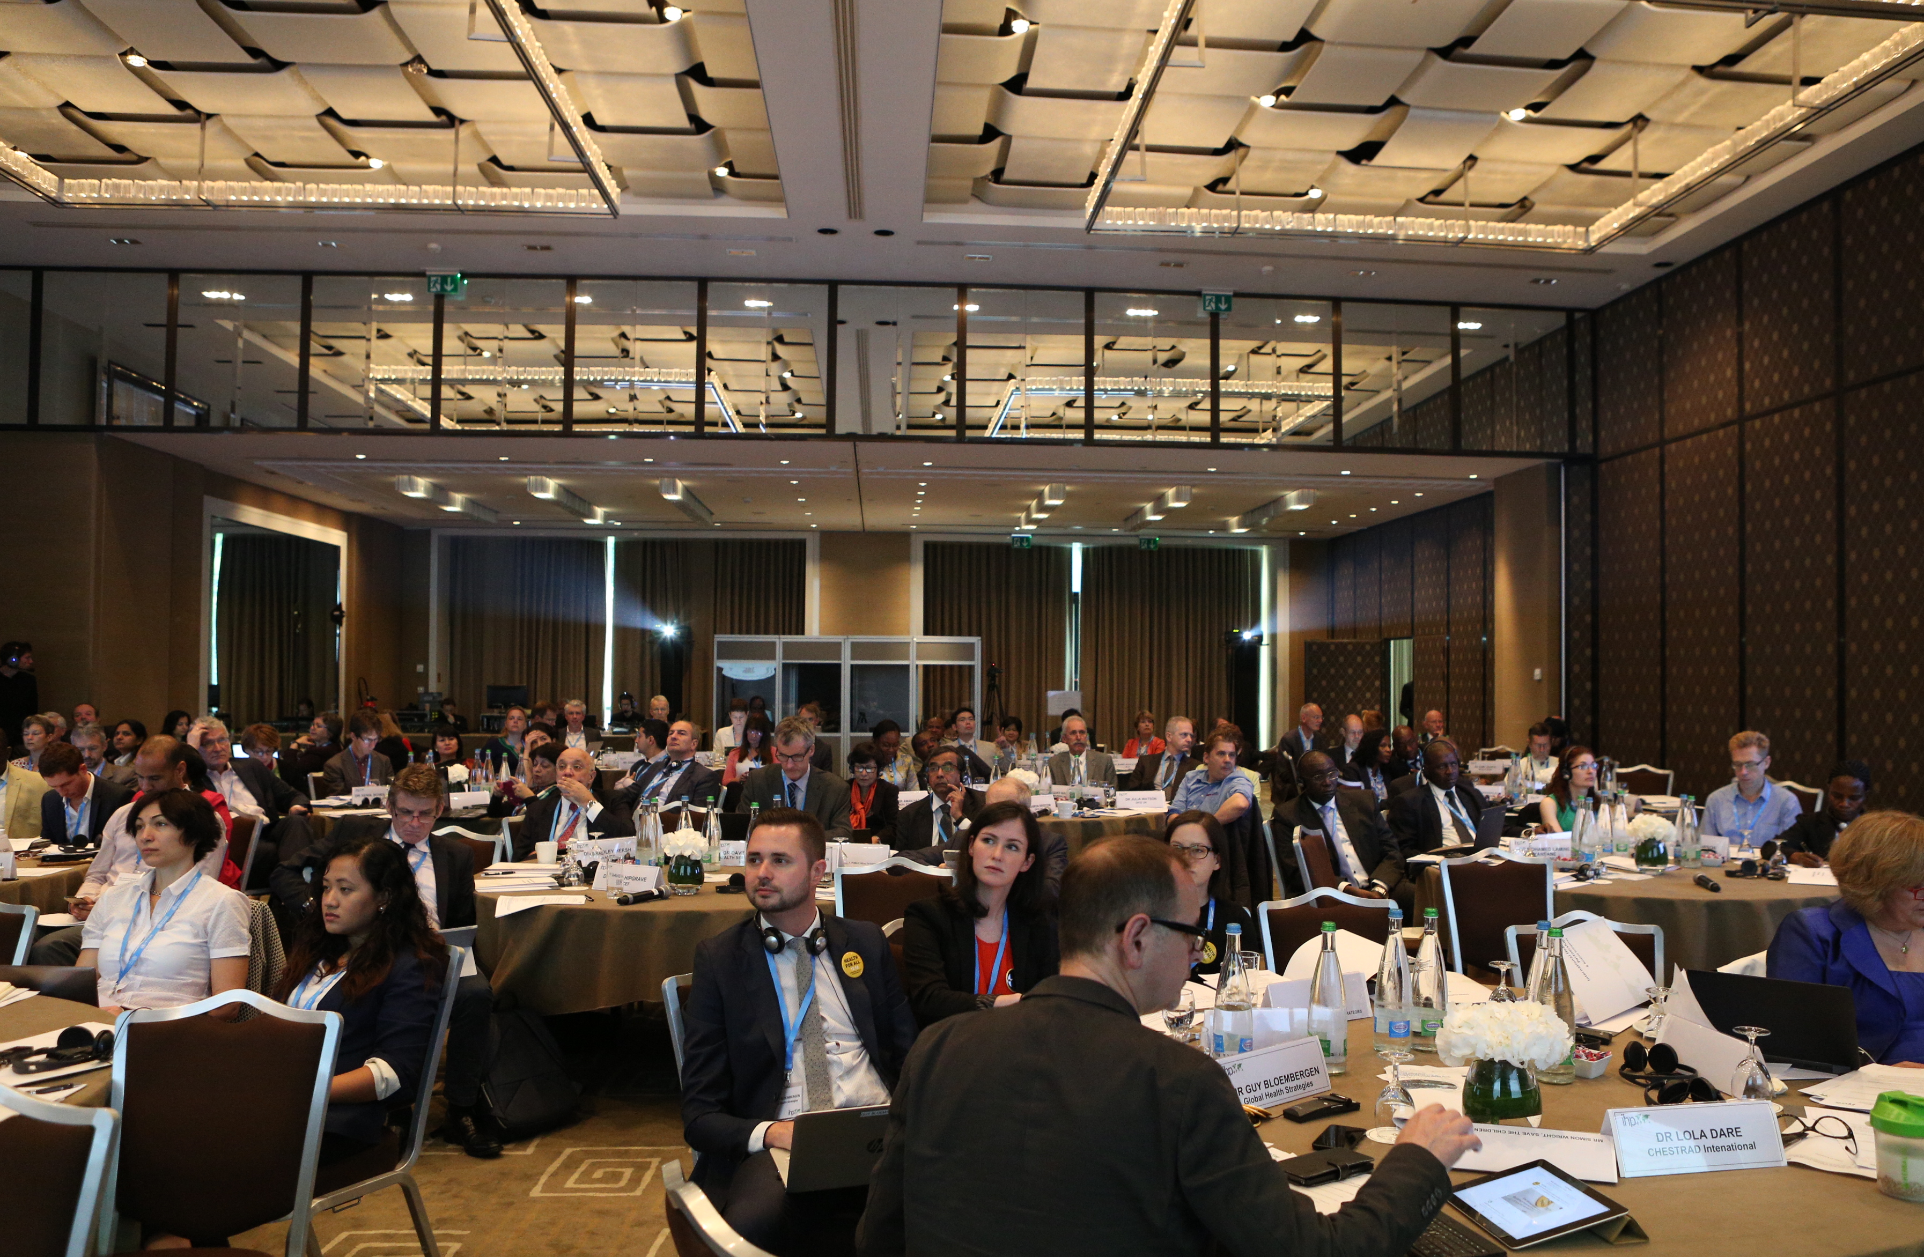
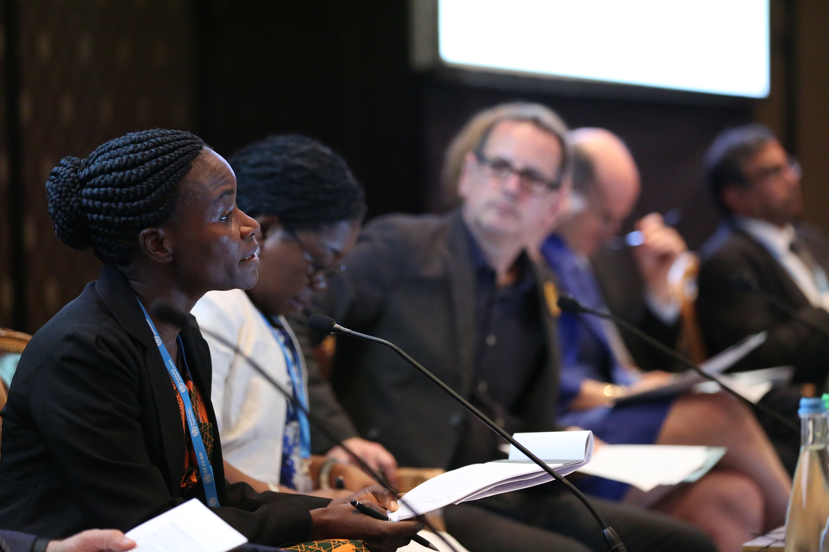
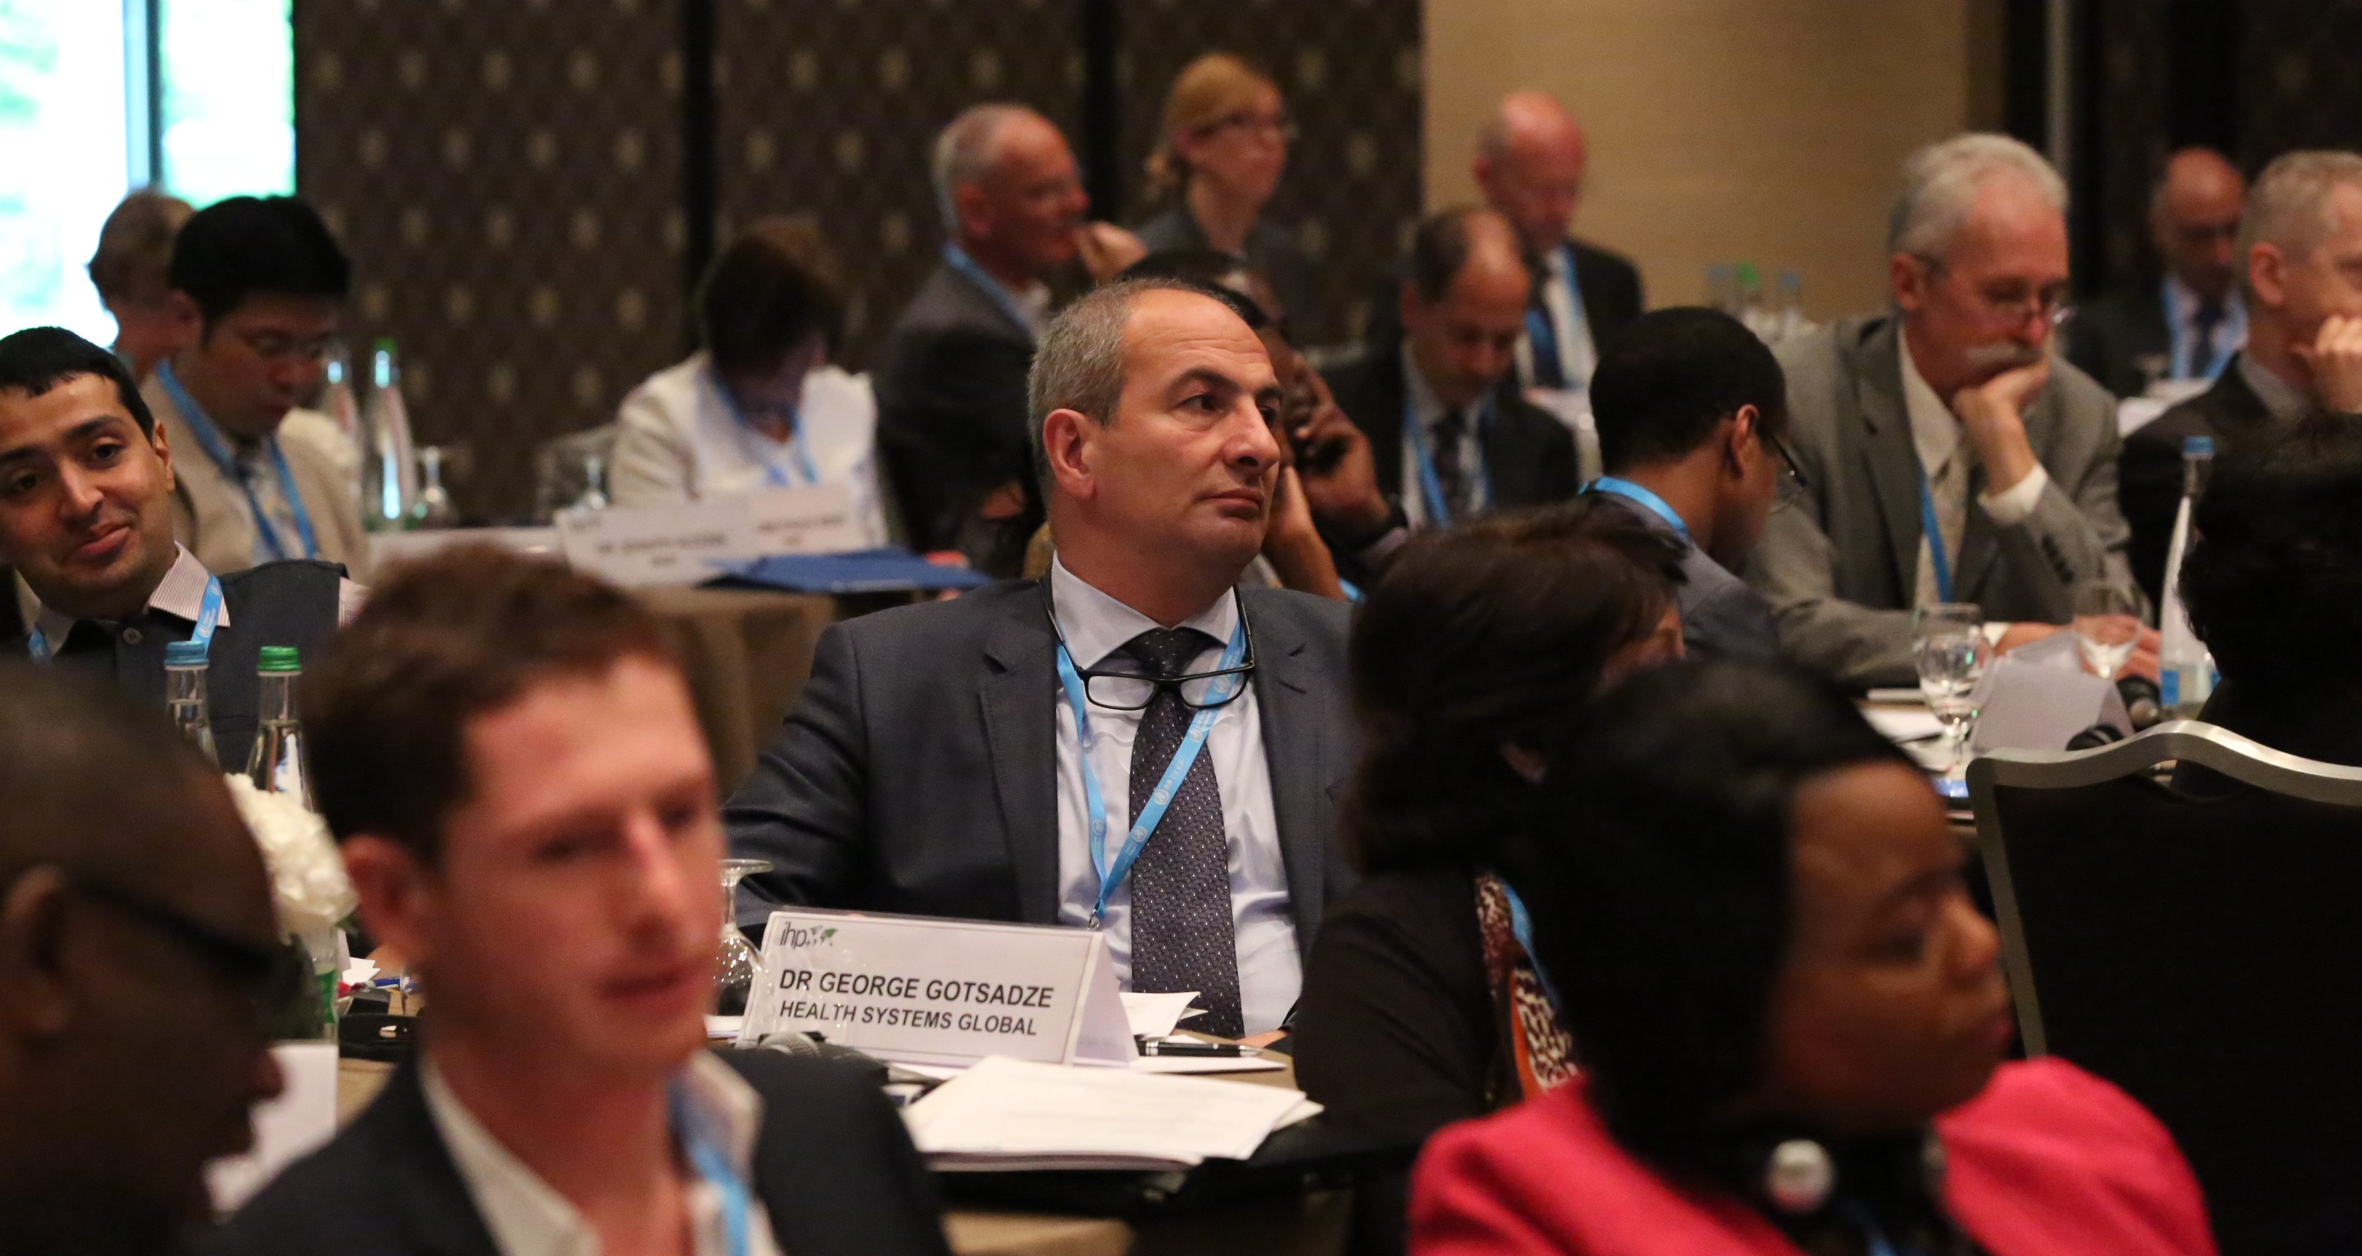
We are listening
& we hear you

Slide 3
The needs are many & clear

Slide 4
Country coordination
Zolia: “the post-Ebola environment is like a nightmare of fragmentation”
80% of funds for Ebola reconstruction in Liberia are off-budget
Short-term focus
Fragmentation with sub-sectoral lens – e.g. GHSA
Undermining governance
Whose priorities, targets & indicators?
Countries want to lead & partners willing to adapt/align
➔Incentives & mutual accountability?
Notes:
Soucat: “Ebola was our 9/11” it woke us up to the limitations in global health and problems with vertical programmes. Need to acknowledge our collective failure
Shift in type of aid and how provided to strengthen systems for sustainable progress
Remco Van de Pas & Tim Roosen: “Where is the global compact for shared responsibility?”

Slide 5
Political economy of UHC & leaving no one behind
Underpinned by the social contract between citizens and state
Bump: “conflicts and contests of interest”
Yates: “we have to engage with the politics”
Thailand: The triangle that moves the mountain
Fairness along the axes of the UHC cube
Reddy: “Health equity must be the compass for judging the performance of health system”
➔Accountability, transparency, participation
Notes:
Emphasis on domestic resources and redistribution
Who gets what, whose views count
Georgia: power of popular demand

Slide 6
We have the opportunity

Slide 7
Evans: “Unprecedented political opportunity”
Wright: “UHC is not business as usual”
Reddy: “UHC provides the soldering and soul of SDG 3”
Soucat: “The first day of the rest of our lives”
Zolia: “renewed commitment to do business differently”

Slide 8
Potential added value of
The International Health Partnership for
UHC 2030
Notes:
We have made great headway with more clarity on what we could collectively do
Will learn from the IHP+ rapid review

Slide 9
A platform for collaboration & coordination
A partnership of the willing
Not about integration, submission or reporting lines
Flexible, nimble & adaptive to local needs
Mapping which initiatives are doing what, where?
Explore different models for working together: Assembly?
Multi-sectoral engagement for policy coherence?
Potential role of country focal points?
Notes:
Including working across different partnerships – e.g. HDC, P4H, HRH Network, JLN

Slide 10
Learning & exchange
Global repository, portal, evidence hub?
Facilitate peer exchange & review?
Accessibility – language, format?
How to complement & leverage existing initiatives – e.g. HSG, JLN etc.?
How to strengthen in-country capacity for health system research?

Slide 11
Accountability
An IHP+ priority but needs adaptation & teeth
Axes: state-citizen & partner-country
Broader agenda: IHP+ behaviours, HSS & UHC
HDC:
Applying IHP+ ways of working to data
Important but not sufficient for accountability
“Evidence with a purpose”: Syntheses? Scorecards? A human face to those left behind?
Review:
Value of independent & multi-dimensional review
Inclusion & participation: who is part of the dialogue?
Remedial action: incentives?
Remedial action

Slide 12
Advocacy: a movement with people at the centre
Build/maintain political momentum
Chatterjee: “build the movement from below”
Dare: “Amplifying voices”
Empowering citizens
Popular awareness, demand, ownership of the agenda
Needs capacity strengthening for evidence-based advocacy & effective participation
Persuasive messaging & communication

Slide 13
Tools & approaches: global public goods
A common approach to:
Health system assessment
Mapping?
Flexibility, adaptable to country context
Include historical perspective, risk assessment, equity at the core
Beyond diagnostic: how facilitate policy dialogue & inform prioritisation? Who is around the table? Joint results framework?
Breadth & depth?
Transition process
Complex & fragile contexts
➔Flexible approach needed
Others? E.g. implementation of HSS support?

Slide 14
Multi-stakeholder engagement
Civil society
Diversity: membership-based, grassroots, CSOs, NGOs, INGOs, faith-based, youth-led…
Roles: watchdog, partner, service provider, advocate
Dare: “an engine of discomfort”
Manage conflicts of interest?
Challenges of competition within civil society?
Integrated platforms on HSS/UHC
Institutionalise participation & facilitate effective representation – whose voice? How to empower the disenfranchised?
Learn from IHP+ experience & other GHIs/partnerships
Need capacity & predictable support (technical & financial)
Private Sector, parliamentarians, academia, media…
Scheijgrond: “are you open… what role would you give us?”

Slide 15
What have we missed?
What’s your key take-away added value?

Slide 16
Transformation process
Consultation
Public online – key questions
Targeted outreach - constituencies not traditionally involved (MICs, HICs, PS, parliamentarians, membership-based CSOs etc.)
Specific consultation on the CSO engagement mechanism
Refine functions, update work programme for 2017, results framework
Updated Global Compact
Transitional Steering Committee – which will include representation of new constituencies
Events, update on progress and maintain momentum – e.g. UNGA
WB/IMF Spring Meetings/WHA 2017: opportunity for new members to sign Global Compact

Slide 17
Thank you!

