Slide 1
Multiple tools, multiple assessments...one health system
Session 7: Harmonisation and a common approach for assessing country health systems – the way forward
Dr. Dheepa Rajan
Department for health systems governance and financing
WHO

Slide 2
3 Broad Different Country Contexts
3 Categories of HSS Support Strategies
HSS country strategies including IHR core capacity and preparedness should be tailored to different country contexts:
Strategy 1: Strengthening health systems foundations in least developed and fragile countries
Strategy 2: Strengthening health system institutions in least developed countries where foundations are already in place
Strategy 3: Supporting health system transformation in countries with mature health systems
A right combination of “essential investments” (strategy 1) and “software” (strategies 1 to 3) external investments are essential to build strong health systems and achieve results in UHC and health security
Notes:
Please note that focus of this presentation is strategy 1 and 2

Slide 3
3 Strategies for HSS “Software”:
Technical Assistance, Policy dialogue and Capacity building
“Software” external investments are needed for all strategies:
Strategy 1: Foundations: the “software” package includes hands-on technical assistance in the “Six gaps” health system areas
Strategy 2: Institutions: the “software” package includes technical assistance, capacity building, and policy dialogue for strengthening health systems institutions
Strategy 3: Transformation: the “software” package includes specific technical assistance to overcome bottlenecks to UHC and health security in mature health systems
In all cases
a Health Systems Assessment is needed
Notes:
“Software” external investments are needed for all strategies and for all countries. They will vary in terms of contents and intensity among the different strategies

Slide 4
Multilateral agencies
Gavi
State and Parastatal organisations
World bank
Ministry of
Finance
BAD
Fonds Social de
la République
IMF
53 specialised
programs
UNFPA
Schools of
Public Health
WHO
13 MoH
Departments
11 Provincial
Ministries of Health
Faculties of
Medicine
UNAIDS
11 provincial
management
team
Global Fund
IHP+
Ministry of
Education
BCECO
UNICEF
EU
WFP
Bilateral Funding / Technical agencies
UNHCR
MOH
(15 Staff)
BTC CTB
GTZ
ACDI
13 Donor Government program
coordination committees
VVOB
USAID
Apefe
SIDA
ECHO
DFID
Salvation
army
BDOM
Memisa
BASICS
Sanru
MSF
Belgium
Louvain
development
ECC
Caritas
Asrames
Damian
Foundation
Merlin
Cemubac
Fometro
World
Vision
PSF-CI
CRS
Cordaid
Oxfam
GB
More than 200 health partners
INGO's (Emergency)
Novib
[Source: Porignon, WHO, 2008]
Int and Nat NGO's (Development and church related)
Notes:
Extra burden on government to manage many partners

Slide 5
Health system assessments – frequent issues in practice
Not systematic
    Place in the planning cycle
    Common language
  Not comprehensive (data, policies, implementation)
  Not participatory (Dept. of Planning or consultants)
  Fragmentation of sources/donors/projects
  Comparisons difficult with other countries
  Lack of continuity – no follow-up

Slide 6
Widely-used tools
WHO health system situation analysis (CHPP):
    Support and promotes the policy dialogue & country planning process in countries (communities of stakeholders), structured around the profiles
    Integrates data, policy and implementation assessments
    USAID Health system assessment approach (HSAA)
WHO Health financing system review (OASIS --Organizational ASsessment for Improving and Strengthening Health Financing)
In development:
PHCPI – Primary Health Care Assessment Guide

Slide 7


Regional tools
WHO EURO
    -- Health system performance assessment
    -- Health System in Transition (HiT)
WHO AFRO -- Africa Health Observatory (AHO):
      Uniform country profiles
      Support to the development of National
      Health Observatories

Slide 8
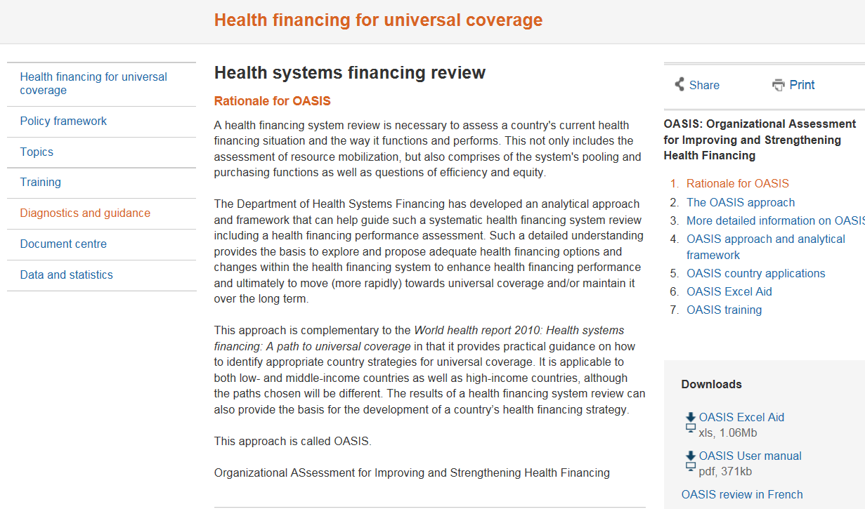
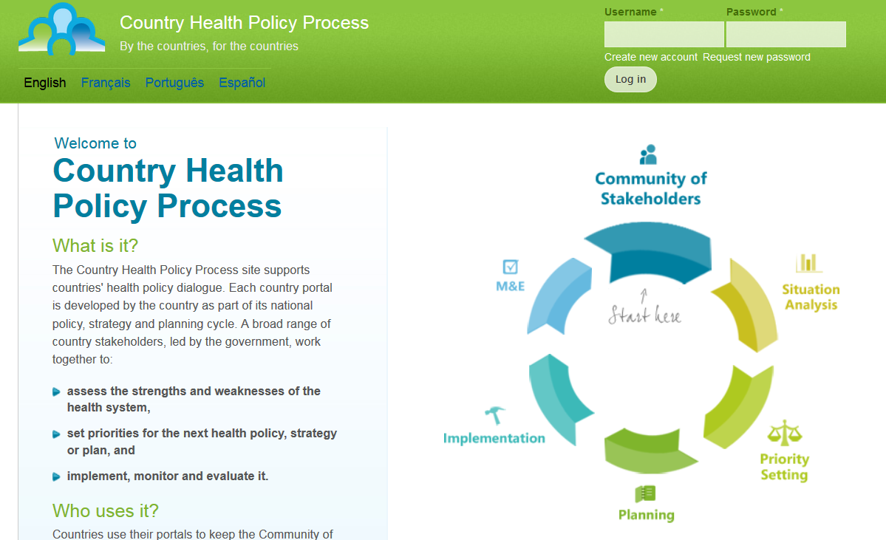


Slide 9


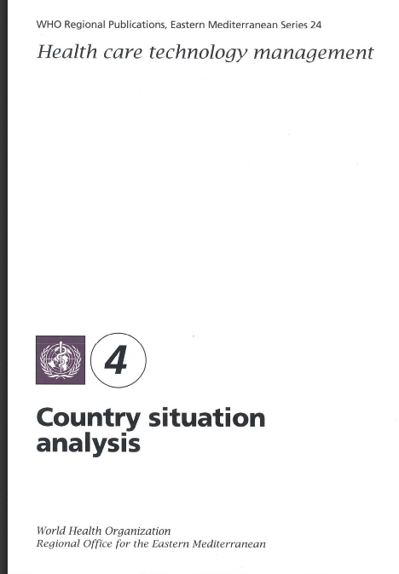
General assessments & ‘deep dives’

Slide 10
Health System Assessment - suggestions
A priority activity of UHC 2030 could be the development of a Joint Health System Assessment tool
JANS has been a foundational tool of IHP+; similarly, a Joint Health System Assessment tool could constitute the backbone of the new UHC 2030
In practice a UHC 2030 inter-agency working group could develop contents and recommended processes for a joint HSA, and review it regularly
The JHSA would be developed and tested by mid-2017

Slide 11

Added value?
Level playing field, comparability
Leverage complementarities of existing methodologies and tools
Avoid duplications and contradictions in results
Align and harmonise different methodologies so as to better compare and analyse

