Slide 1
Engaging CSOs in UHC 2030
Bruno Rivalan
IHP+ Northern CSO Representative
IHP+ Steering committee
21th June 2016

Slide 2
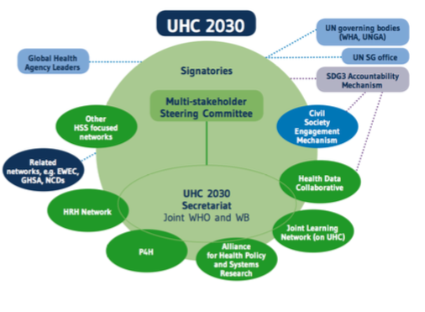
UHC 2030 structure

Slide 3
IHP+ CSO engagement mechanism
Represented in IHP+ bodies
Reflected in IHP+ guidelines
Supporting advocacy of country-based CSOs to engage in health sector dialogue and processes –HPAF
Notes:
such as JANS and mutual accountability monitoring process

Slide 4
IHP+ CSO engagement mechanism
Impact
Challenges
Participation is increasing in health planning and policies since 2005
Unmet need for broad CS engagement to address cross-cutting systemic issues
Seen as a reliable source of evidence
Less participation when key decisions are taken
HPAF not a scale to show significant progress
Lack of community involvement
Weak link between local, national and global

Slide 5
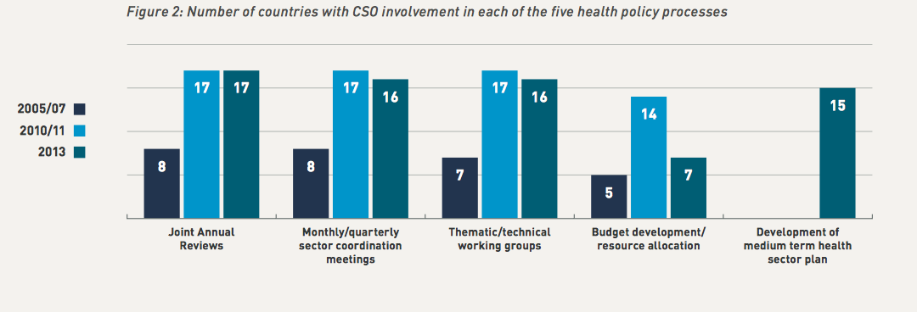

Slide 6
Comparing CSO support frameworks from major GHIs
 | IHP+ | GFATM | Gavi | GFF
Participation in governing bodies | Yes | Yes | Yes | Yes
Country level guidelines | Recommended | Mandatory | Recommended | NC
Financial support country level | Small grants | Dual track funding Advocacy support Multicounty grants | Country platform support Regional grant | No
Financial support global level | 0,5 FTE 1 annual meeting | 1FTE / delegations Pre board meetings | 2FTE + prep board meetings | No

Slide 7
Learning from CSO engagement frameworks
Explicit function of CSOs in UHC 2030 should be clearly defined
Institutionalisation is critical –Independency is vital
Diverse representation and transparency are needed
Flexibility - No single way to support CS engagement in national health policy processes
Direct financial support and capacity building are critical and interlinked
Long time frame for results as building relationships with government officials takes time
Strong commitments at the highest political level
Notes:
Global initiatives and donors have a role to play in supporting CSOs being this credible partner at the country level
and money and engagement and accountability framework should be tailored accordingly

Slide 8
UHC 2030 CSO Engagement Mechanism- Why and What
Why a CSO engagement ?
to raise political momentum on citizen demand
to influence policy design and implementation through an equity focus agenda
to strengthen citizen-led and social accountability mechanisms at sub national, national, regional and global level
What role for CSOs ?
Representing the CSO voice in UHC Alliance including participation in the UHC Alliance Steering Committee
Facilitating information sharing across CSO network on advocacy and accountability efforts for health systems and UHC from global to local and vice versa
Monitoring of UHC implementation at country level with the production of independant report
Coordinating advocacy, consultations, communication and engagement of CSOs in global and regional UHC processes
Coordinating and collaborating with other related initiatives
Facilitate CSO Capacity building

Slide 9
UHC 2030 CSO Engagement Mechanism – How
As the IHP+ is shifting to a UHC alliance - The CSO engagement mechanism should be
based on existing IHP+ CSO engagement
while expanding members, mandate, functions and expertise to be aligned with the new UHC Alliance
Civil society engagement mechanism proposed governance and organisation
CSO country groups members: CSOs platforms working on UHC/HSS at country level to participate in UHC alliance country mechanism as well as direct advocacy, accountability and bottom up information sharing
CSO advisory group with CSOs representatives from diverse regions and health constituencies to set the priorities for the CSO coalition and agree on the workplan
CSO participation in the UHC Alliance Steering Committee: 3 CS representatives and 3 alternates to represent CSOs in UHC Alliance Steering Committee
CSO secretariat: A co-hosted secretariat to deliver the workplan, with a coordinator in the Alliance Secretariat and another in a CSO organisation based in the south ( option supported by the IHP+ Core team )

Slide 10
Moving forward
Find a consensus on the exact role of CSOs in UHC 2030 ?
Ensure a large consultation with CSO to get their visions reflected and proposed a strong CSO mechanisms where the national citizens voices can be heard
Avoid creating additional structures and silos at country level - Need to discuss how to do it
Get a clear commitment on the level of ressoruces dedicate to CSO mechanism

Slide 11
Guidance on Civil Society Engagement in Country Health Sector Teams. 2012. International Health Partnerships.
“The role that civil society plays in achievingd better health outcomes and outputs at the country level is critical.
Civil Society Organizations possess a wealth of experience and provide insight into gaps of health service delivery and the real, practical, and political challenges that need to be overcome to make progress in achieving improved health outcomes and status.
They also have hands- on experience and knowledge of what works in many different settings for various communities that can offer solutions to some of these challenges.”

