Slide 1
Launched March 9 2016 at UN Statistical Commission in side event

Slide 2
IHP+ Country-led platform for monitoring & accountability (2010)
External validation and estimates
Common standards and tools
GAVI
reporting
Monitoring
reports
Country
data
generation
& compilation
MDG / UN
reporting
Analysis
& synthesis
Country data
information
generation
& compilation
Global Fund
reporting
Evaluation
Reviews
Programme
reports
Statistical
reports
Reviews
Independent
reviews
Data quality
assessment
PEPFAR
reporting
Programme
Reporting
(TB, MCH,
HIV, etc.)
Minimization of
reporting requirements
Harmonization of
reporting requirements

Slide 3
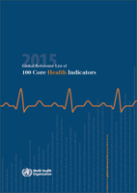
Commission on Information & Accountability for Women's and Children's Health (2011-2015)
Built upon IHP+ M&E framework:
With focus on women and
children's health
60+ countries engaged
>$40M
Monitor
Review
Action

Slide 4
The 17 Sustainable Development Goals 169 targets
Poverty
Food security and nutrition
Health
Education
Gender equality
Water and sanitation
Energy
Economic growth and employment
Infrastructure, industrialization, innovation
Equity
Cities
Consumption and production
Climate change
Oceans, seas and marine resources
Ecosystems
Peaceful and inclusive societies
Means of implementation
Red: risk factors with direct effect on health
Determinants: with indirect effect on health

Slide 5
Country Health Data & the SDG
Positive
Global SDG indicator framework – health comprehensive
26 indicators under health goal 3; UHC central
Fits within WHO Global Reference List of 100 Core Health Indicators
Dozen+ of health-related indicators in other goals / targets
Country SDG health indicator framework
Many countries already have good set of indicators and targets for regular health sector reviews, and use them
Can be adapted to align with SDG as relevant
Challenges
Persistent data gaps
Regular (health) surveys
CRVS system strengthening
Health facility data sources
Administrative data (HRH, financing etc.)
Health statistical capacity
National Statistical Offices
Ministry of Health
Public health and research institutions / academic
Requires
Investment in health data (domestic, global)
Harmonized and aligned support for strengthening country analytical capacity
Greater collaboration between health and statistical constituencies

Slide 6
Measurement for Health Summit June 2015
Agree on priority actions required to build robust systems for national priorities and monitoring SDGs
Address challenges facing countries (fragmentation, disjointed efforts etc.) and reduce reporting burden
Common Roadmap and 5-Point Call to Action:
Increase level and efficiency of investments
Strengthen country statistical capacity
Address data gaps including CRVS
Use innovation to improve facility and community data systems
Enhance use and accountability

Slide 7
Health Data Collaborative: strategies, output, result
Strategies
1
Alignment of funding and technical support for a single strong country health information system
2
Package of standards, tools and repository of information available to all countries
Output
Increased efficiency and better results of domestic
and external investments in health data
Result
Strengthened country systems for monitoring programmes & accountability
and
Better reporting (sub)national and global progress on SDG

Slide 8
Global and regional level: Complementarity, alignment, gaps
Core group with focal points in key agencies / institutions and countries
Broad steering group
Small secretariat
Technical Working Groups and regional networks: leveraging existing collaborations and initiatives where possible
HDC core team
WG: Population data sources
WG: Facility & community data (including DHIS)
WG: Health systems monitoring
Int Household Survey Network
DHS-MICS-LSMS
Regional platform
(e.g. AEHIN)
WG: Country action & regional networks
Regional network (CHESTRAD)
PHCPI Measurement & performance
CRVS coordination mechanisms (IAWG, + regional bodies)
WG: Data analytics, use and open access
Regional networks
Existing collaborative platforms
HDC WGs

Slide 9
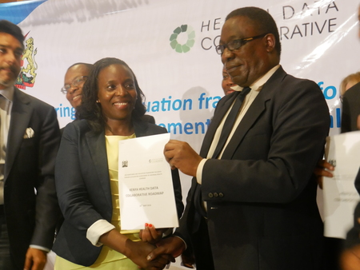
Country action Kenya Health Data Collaborative
Demand driven
Country leadership - specifics
Priority actions - roadmap
Roles and responsibilities
IHP+ / UHC 2030 movement linkages
Assess UHC progress
Mutual accountability

Slide 10
To-date: 32 partner commitments

