Slide 1
Transition Challenges and Opportunities – Preliminary Findings of Country Consultations
November 3, 2017

Slide 2
Why should UHC2030 consider Transition?
Immunization budget stabilized or increased
INFLUENCERS OF TRANSITION
Economic & demographic factors
Evolving political landscape
Rapid private sector growth
New health priorities
Reduced donor support
Domestic revenue pressure
Vulnerability of UHC Agenda
UHC2030
INTENDED OUTCOMES
Progress towards UHC continues
Quality & robustness of services improve

Slide 3
Scope
Core Objectives
Present stakeholder perspectives on key transition-related health system challenges, opportunities and policy responses that influence progress towards UHC
Inform discussion of possible ways for UHC2030 WG to provide support to countries during transition

Slide 4
Country selection criteria
Country | UHC (financial protection) OOP%THE | Real GDP growth (%) | Total health exp pc (USD) | External resources % THE | Govt health exp % total govt exp
Low-income countries
Nepal | 48 | 6.0 | 40 | 12.6 | 11.2
Lower-middle income countries
Kyrgyzstan | 39 | 4.0 | 82 | 8.6 | 11.9
Myanmar | 51 | 8.0 | 20 | 21.8 | 3.6
Papua New Guinea | 10 | 7.4 | 92 | 21.1 | 9.5
Sri Lanka | 42 | 4.9 | 127 | 1.3 | 11.2
Zambia | 30 | 4.7 | 86 | 38.4 | 11.3
Upper-middle income countries
Panama | 22 | 6.1 | 959 | 0.7 | 14.6

Slide 5
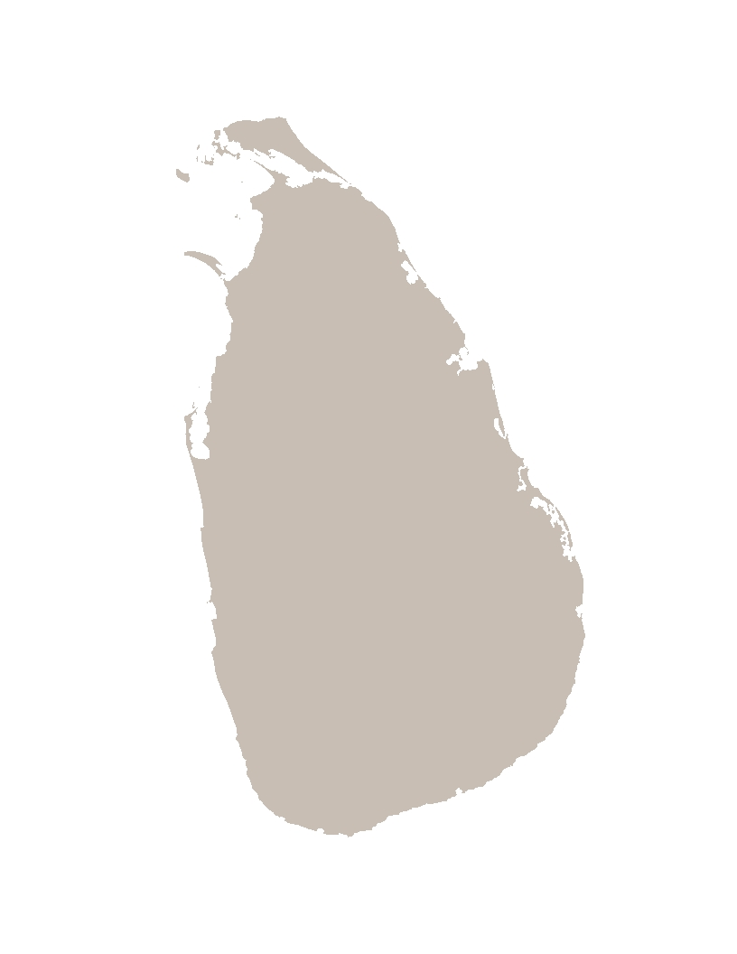
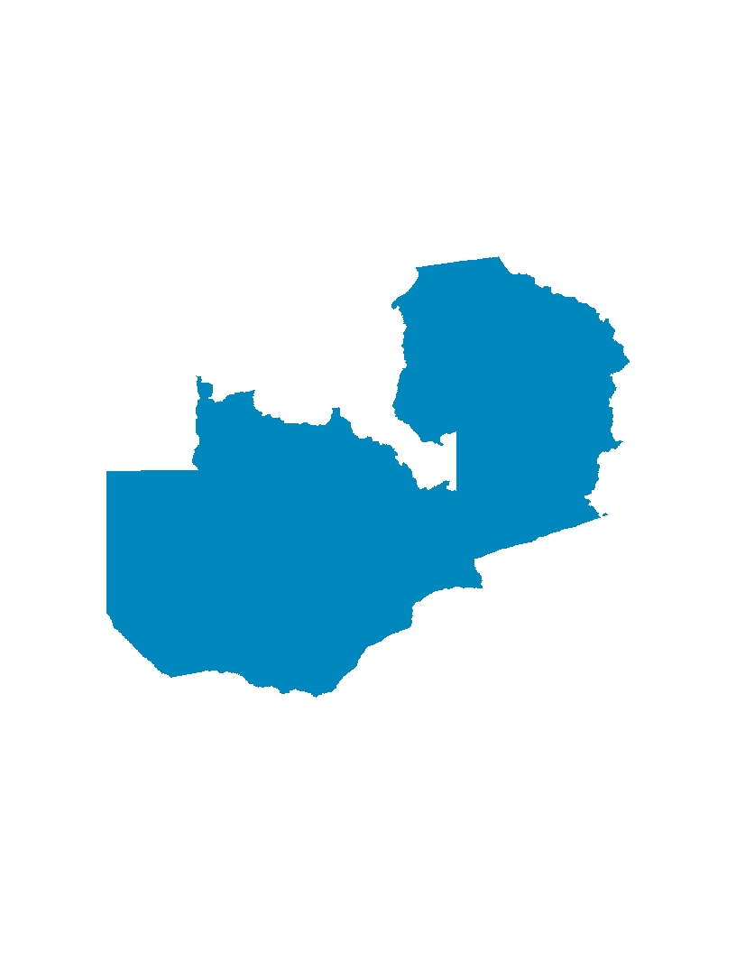
Countries reviewed
Papua New Guinea (LMIC)
Kyrgyzstan (LMIC)
Active: DFAT, GFATM, WB (blend)
In transition: Gavi
Active: Gavi, GFATM, KfW,
WB (IDA)
In transition: USAID
Transitioned: DFID, JICA, UNFPA
Nepal (LIC)
Myanmar (LMIC)
Active: DFID, GFATM, Gavi, KfW, Japan
Started dialogue: WB (IDA)
Transitioned: DFAT (2014)
Active: GFATM, DFID, Gavi,
Japan, WB (IDA),
3MDG (4 active donors,
3 phased out)
Panama (UMIC)
Active: IDB loan, WB (IBRD)
Started dialogue: GFATM (HIV)
In transition: GFATM (TB)
Sri Lanka (LMIC)
Active: KfW, WB (IBRD)
Started dialogue: GFATM (HIV+TB)
In transition: GFATM (malaria)
Transitioned: Gavi (2015)
Zambia (LMIC)
Active: DFID, GFATM, Japan, USAID, WB (IDA)
Started dialogue: Gavi
In transition: EC
Transitioned: KfW (2013)

Slide 6
Methodology
Conducted review of national and global-level documents
Conducted 34 key informant interviews
WHO
DFID
DFAT
Donor transition policies
Global reports on transition approaches and lessons learned
National health plans
National health financing strategies
SWAp minutes
World Bank
MOH
Gavi
3MDG
CSO (pending)

Slide 7
Exploring the Issues

Slide 8
Six Themes
Coverage for Vulnerable Populations
Vulnerable populations at risk of losing coverage
Governance of central programs
Centrally managed programs face evolving governance structures
Domestic revenue generation
Political challenges to raising revenues create risk for funding gap
Private Sector Participation
Growing private sector offers opportunity for accelerated UHC progress – if managed
Donor Capacity
Adequate donor capacity required to have meaningful engagement in UHC agenda
Mutual Accountability
Accountability for transition outcomes must be shared by donors and governments

Slide 9
Six Themes
Coverage for Vulnerable Populations
Vulnerable populations at risk of losing coverage
Governance of central programs
Centrally managed programs face evolving governance structures
Domestic revenue generation
Political challenges to raising revenues create risk for funding gap
Private Sector Participation
Growing private sector offers opportunity for accelerated UHC progress – if managed
Donor Capacity
Adequate donor capacity required to have meaningful engagement in UHC agenda
Mutual Accountability
Accountability for transition outcomes must be shared by donors and governments

Slide 10
Trend: Vulnerable populations stand to lose coverage during transition
Non-state providers offer substantial coverage for vulnerable populations
Political considerations often constrain willingness/ability of governments to absorb costs
MoH lacks capacity/mandate to continue providing services to those populations.
Some MoH exploring how to contract with non-state providers.
Non-state providers forced to mobilize resources on their own.
Current Status
In their words…
I
“Conflict areas and specific ethnic groups are being attended by CSO which are funded by donors. These populations are not covered by the government…” (Myanmar)
“Donor funded islands-projects for extension of coverage in hard-to-reach rural areas and indigenous populations, lacking of good quality and supervision, not included in MoH programs.” (Panama)

Slide 11
Future scenarios for Vulnerable population coverage
Vulnerable population groups lose coverage and access to priority health interventions
Reduced financial protection, increased OOP
Funding for vulnerable populations face potential volatility
Sustained coverage and financial protection for vulnerable population
UHC2030 Engagement Outcome Scenario
Include vulnerable population groups explicitly in any transition dialogue
Support focused advocacy campaign to maintain coverage for vulnerable populations

Slide 12
Six Themes
Coverage for Vulnerable Populations
Vulnerable populations at risk of losing coverage
Governance of central programs
Centrally managed programs face evolving governance structures
Domestic revenue generation
Political challenges to raising revenues create risk for funding gap
Private Sector Participation
Growing private sector offers opportunity for accelerated UHC progress – if managed
Donor Capacity
Adequate donor capacity required to have meaningful engagement in UHC agenda
Mutual Accountability
Accountability for transition outcomes must be shared by donors and governments

Slide 13
Trend: Structural changes in health financing architecture is putting pressure on how central programs are governed
Donor financing mandated strong centralized planning and management structures for key vertical programs (FP, Immunization, HIV/AIDs)
Financing of traditionally centralized programs (immunization, FP) still considered a centralized function, though shifts imminent as financing mechanisms mature
As donors exit and financing evolves, question of how centralized programs are governed becomes paramount.
Countries embarking on strategic purchasing or fiscal decentralization often lack capacity to prioritize key public health priorities
Current Status
In their words…
I
“In the current decentralization that Nepal is undergoing, development partners want to see how funds will be deployed and what will be the accountability mechanism, and only then they will determine how to work with local bodies.” (Nepal)
“Most external funding is managed outside of the government. All budgetary decisions are made at the technical program level, and therefore MOF is not involved at all.” (Myanmar)

Slide 14
Future scenarios for governance of vertical programs
Centralized programs ‘confused’ in face of strategic purchasing & decentralization
Transition threatens existing structures mandated by donors
Governance of key central programs will weaken, resulting in reduced coverage
Strong and evolved governance of public health programs in place post-transition
UHC2030 Engagement Outcome Scenario
Create transition “workstream” focused on governance of central programs
Focused TA on central program governance

Slide 15
Six Themes
Coverage for Vulnerable Populations
Vulnerable populations at risk of losing coverage
Governance of central programs
Centrally managed programs face evolving governance structures
Domestic revenue generation
Political challenges to raising revenues create risk for funding gap
Private Sector Participation
Growing private sector offers opportunity for accelerated UHC progress – if managed
Donor Capacity
Adequate donor capacity required to have meaningful engagement in UHC agenda
Mutual Accountability
Accountability for transition outcomes must be shared by donors and governments

Slide 16
Trend: Domestic revenues to fill transition gap requires a political response
Resource mobilization in countries is a robust political endeavor – most donors approach it as a technical exercise.
Lack of focus on creating a robust movement containing a wide range of actors.
Health sector is often not well equipped to lead advocacy efforts.
MOF pushes back on more funding before health sector demonstrates efficiency gains.
Within MOH, internal absence of capacity to use evidence to inform budgeting.
Current Status
In their words…
I
“We try to make the case for the government to increase the overall health budget, but MOF doesn’t agree and talk about improving budget execution first.” (Nepal)
“It is not easier to mobilize resources just because you’re growing economically. MOH needs to do more to articulate the need for funding for health, and be systematic and strategic about its revenue generation.” (Myanmar)

Slide 17
Future scenarios for Domestic Revenues
Countries will not be able to mobilize sufficient resources to sustain priority interventions
Health sector will continue to be less prioritized than other sectors in budgeting
Strategic and tailored advocacy will contribute to increased domestic revenue generation
Domestic revenues insufficient to fill transition gap
UHC2030 Engagement Outcome Scenario
Identify champions and aligned interests to engage key stakeholders
Support countries in developing high-level advocacy strategy

Slide 18
Six Themes
Coverage for Vulnerable Populations
Vulnerable populations at risk of losing coverage
Governance of central programs
Centrally managed programs face evolving governance structures
Domestic revenue generation
Political challenges to raising revenues create risk for funding gap
Private Sector Participation
Growing private sector offers opportunity for accelerated UHC progress – if managed
Donor Capacity
Adequate donor capacity required to have meaningful engagement in UHC agenda
Mutual Accountability
Accountability for transition outcomes must be shared by donors and governments

Slide 19
Trend: Rapid private sector growth is often not guided towards achieving UHC objectives
Private sector delivery growing rapidly in many transitioning countries
Regulatory systems are weak and market shaping opportunities are not fully leveraged
Private sector is often focused on ‘low-hanging fruit’ – curative services for wealthy populations
Enormous market opportunity of low income populations not realized
Current Status
In their words…
I
“There’s limited regulation of the private sector, but real opportunities for them to try to support the MOH in how to deliver specialist services.” (Nepal)
“The public cannot reach everywhere...the private sector can play a big role here, around health financing strategy, how to reach underserved... but how will the contracting of services work within a government-led system?” (Nepal)

Slide 20
Future scenarios Private provision
Private provision will continue to grow
Opportunities to serve low/low-middle income will continue to expand
Unregulated growth of private sector will result in inequitable coverage
Market optimized for private participation to support UHC
UHC2030 Engagement Outcome Scenario
Market shaping activities to address gaps between private providers, investors, and government
Regulatory efforts to support coherence in private provision
Government capacity to engage private providers

Slide 21
Six Themes
Coverage for Vulnerable Populations
Vulnerable populations at risk of losing coverage
Governance of central programs
Centrally managed programs face evolving governance structures
Domestic revenue generation
Political challenges to raising revenues create risk for funding gap
Private Sector Participation
Growing private sector offers opportunity for accelerated UHC progress – if managed
Donor Capacity
Adequate donor capacity required to have meaningful engagement in UHC agenda
Mutual Accountability
Accountability for transition outcomes must be shared by donors and governments

Slide 22
Trend: Mutual accountability for outcomes post-transition are needed
Most donors do not consider health system readiness indicators as part of their transition criteria
There are no clear implications if the roles and responsibilities established in a transition process are not respected
Transition frameworks do not allow for countries to hold partners accountable if they provide insufficient support throughout the process, delay disbursements of transition grants, or provide confusing/incorrect information on what is expected of the country, etc.
Current Status
In their words…
I
“Donors shouldn’t push a country towards transition if it clearly has nor the financial nor the programmatic capacity to take it over.” (Papua New Guinea)
“Although donors are pushing the government, and explaining what moving into middle income status will mean, the country’s expectation is that donors will not only continue to fund, but also that they will provide sector support rather than off-budget support through earmarked activities.” (Nepal)

Slide 23
Future scenarios: Mutual accountability
No clear consequences if either country or donor does not follow up on commitments
Individual donors risk losing credibility if other donors take over in countries where political will is lacking
Effectiveness and outcomes of transition process varies based on in-country donor and MOH capacity and commitment
Efficient and effective transition processes which sustain and advance their progress towards UHC
UHC2030 Engagement Outcome Scenario
Donors should hold each other accountable for in-country progress
Create an environment to encourage open and critical feedback from countries on process

Slide 24
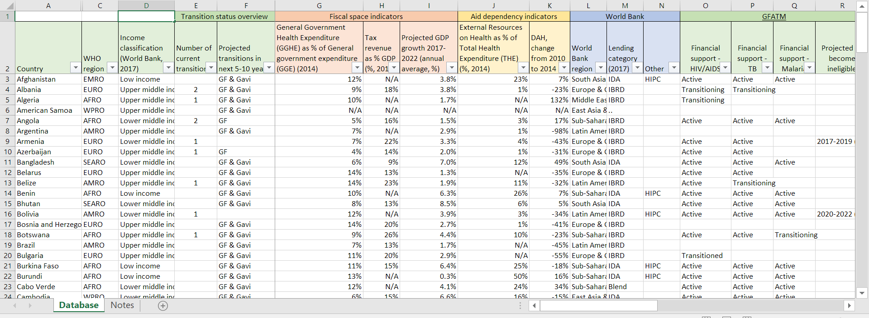
GLOBAL MAPPING TOOL
Offers an overview of the financial support for health from the WB, GFATM, Gavi, Germany, EC, France, Japan, and hopefully more in the future
Includes all low and middle income countries
Shows where DPs are active, where programs are (or are expected) to transition
Also includes a number of fiscal space and aid dependency indicators
Possibility to filter by income grouping, geographic location, number of transitions

Slide 25
Thank you

