Slide 1
UHC2030 Private Sector Constituency: Building a Healthier World Together
Update for the Steering Committee
December 14, 2018
World Economic Forum ®

Slide 2
Agenda Overview of private sector constituency
Who we are
Our vision
Some reflections
World Economic Forum ®

Slide 3
Who we are Private sector constituency members and their support
13 Constituency Organizations
Great interest in the constituency (over 30 companies joined an initial informational call about the application process)
Yet, many companies could not meet the deadline to apply: they require a series of approvals to apply and it takes them an average of 3-4 weeks to prepare the simple application
A few companies discovered relationships with entities that would not allow them to pass FENSA. They are taking actions to address this & apply in the next intake
A few companies found the compact language challenging: “rights-based” language (compulsory licensing)
Mixed interest in the core group: half want to wait and see what happens before they dedicate time to it
Non-health companies working on health interested to join: insurance, financial services, supply chain…
No small country level operators: we could partner with Center fir Health Market Innovations
Company | Based in | Area | Core Action Group?
Apollo Hospital | India | Provider | No
Henry Schein | USA | Technology | No
International Federation of Pharmaceutical Manufactureres and Associations | Switzerland | Pharma | Yes
Japan Pharmaceutical Manufacturers Association | Japan | Pharma | Yes
Johnson Johnson | Belgium | Pharma | Yes
Kenya Association of Pharmaceutical Industry | Kenya | Pharma | Yes
MEDx eHealthcenter | Netherlands | Technology | Yes
Merck | USA | Pharma | Yes
Novo Nordisk | Denmark | Pharma | No
Organisation of Pharmaceutical Producers of India | India | Pharma | Yes
Pfizer | USA | Pharma | No
Royal Philips | Netherlands | Technology | No
Sanofi | France | Pharma | No

Slide 4
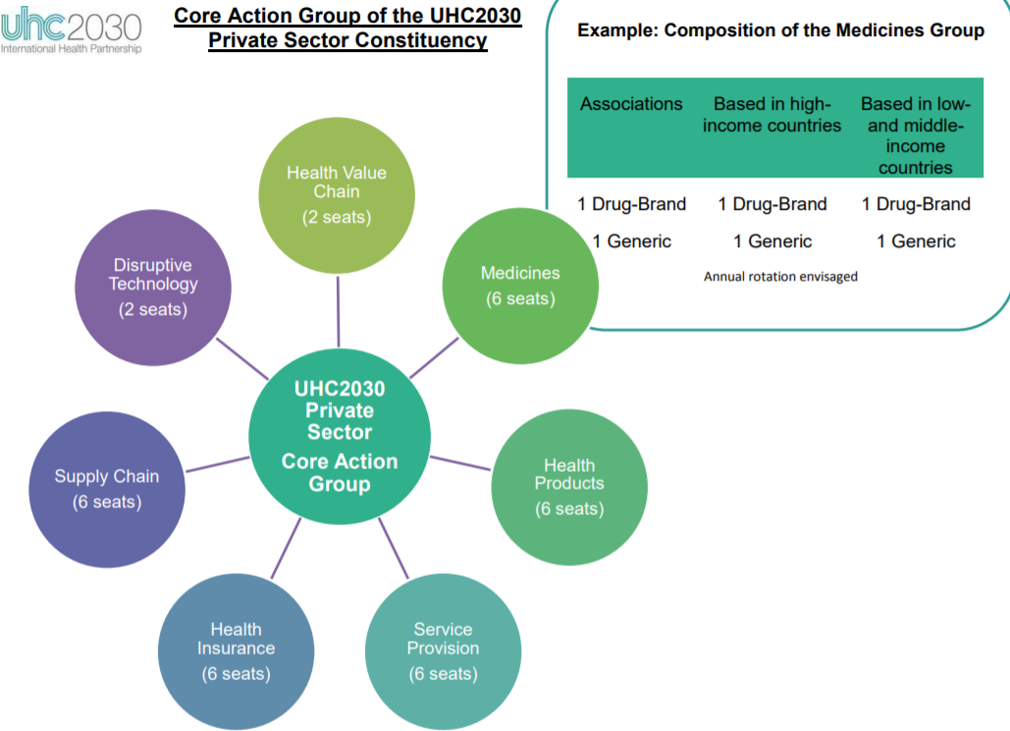
Who we are Private sector constituency distribution (current vs. target)
CURRENT
TARGET
Pharma
5 global companies (Sanofi, Merck, JNJ, Novo, Pfizer)
4 Branded Associations (Kenya, India, Japan, International)
Med Tech / Medical Devises
2 global companies (Philips, Henry Schein)
1 national company (Nigeria)
Provider
1 national company (India )
Current participation from 3 sectors vs target from 7 sectors
Almost 70% of companies represent the pharma sector
Need to rethink the concept of Core vs Consultative Group given the distribution & number of Constituents
Need to broaden the representation base and the number of partners

Slide 5
Our Vision
Initial Thoughts
Vision
To be the trusted “go to” community for advice , advocacy (and eventually joint action) on issues related to private sector engagement in UHC
Objectives
To build (i) trust, (ii) mutual understanding around the UHC concept and (iii) the role of private sector in it
To serve as a Platform for private sector engagement in UHC, i.e. for knowledge sharing, policy dialogue, showcasing member activities, promotion of principles, match-making
To contribute to the work of UHC2030: (i) plug into the new workplan; 2) co-develop and provide feedback on UHC2030 Partnership on its products, technical working groups, etc.
Activities
Administrative: Develop a Governance structure to address the following questions: (March / April, 2019)
What working processes would it need and how would it be organized to enable them?
What kind of community management structure should the Constituency have?
How would it provide joint feedback for Steering Committee meetings ?
How would it provide individual feedback on UHC2030 Products?
How would it develop joint products (e.g., Annual Work Plans, Convenings, etc.)
Technical: Convenings (initial list)
To create awareness & advance knowledge exchange agenda
Regional: (i) Africa Health Agenda International Conference, March 5-7, 2019; (ii) Vietnam with Harvard & Novartis & Amref April, 2019, (iii) WEF Africa Meeting, June 2019; other???
Global: (i) Davos, Jan. 2019; (ii) WHA with DevEx, Amref in May 2019; UNGA High Level Meeting in Sep. 2019; other ? ?
Key learnings document based on the convenings on the role of PS across regions around joint understanding of UHC and the role of the private sector in it

Slide 6
Comments for the Steering Committee Messages to be addressed as we move forward
PS wants to better understand UHC2030, its work, and its members
PS is very interested in engaging in UHC2030 especially with governments: they need predictable, long term national plans to make investment decisions
PS wants to be integral part of UHC2030 Partnership and receive mandates for its work from the Steering Committee, i.e. what deliverables would you like to see from the constituency
PS is eager to take actions and / or gain an understanding about the ultimate objectives of the advocacy efforts of UHC2030
PS definition needs to be revisited to include a broader spectrum of organizations (e.g., not-for -profit service delivery organizations; non-health companies – supply chain, financial institutions, etc.)
World Economic Forum ®

Slide 7
Next steps Moving forward together in the next 3 months
Solicit individual feedback from each member on vision, activities, governance, etc.
Develop a Work Plan
Publicize the new call for applications
Plan convenings, i.e. session on UHC2030 in Davos
Develop a platform for on-going communication with you (initially by e-mail, eventually Toplink) to keep you informed on developments. Monthly update e-mails.
World Economic Forum ®

