Slide 1
A year of progress on global and country coordination on PHC
Agreement to establish a PHC Partners WG
Convenings
Community of practice on PHC implementation
Leveraging existing ones such as the Joint Learning Network, Community Health Roadmap, Health Harmonization in Africa, etc.
Political advocacy
UHC Partnership, G20 and G7, regional bodies (ASEAN, African Union …), groups of nations, regional public health authorities
Meetings, Astana, WHA, UNGA, PMAC etc.
Variety of international, bilateral and other agencies, foundations: WHO / UNICEF leads
Replicated at each level
SDG3+ Global Action Plan
Country govt leadership & coordination

Slide 2
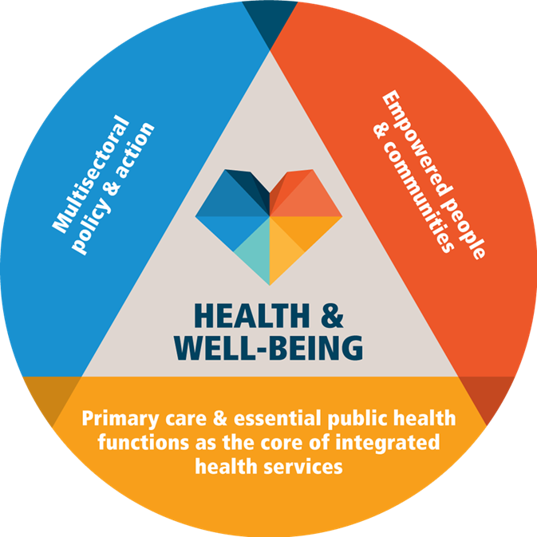

Slide 3
Overarching and undergirding principles of partnership
Country ownership: countries with clear vested interest and willingness to engage in the post-Astana PHC approach
Bottom-up approach: country-level PHC support plans to be developed at country-level; partners supported by their respective Regional Offices and HQs; clear communication & coordination
Tailored approach: PHC support plan responsive to national priorities and context, leveraging the comparative advantage of active health development partners in country

Slide 4
Common global products needed / in devt
Global guidance on health systems assessment (for PHC)
Global guidance on operationalization of PHC
Global guidance on PHC progress monitoring

Slide 5
1. Common health systems assessment approaches
National health sector reviews
Health system assessments (most agencies!)
Roadmap processes (Community health roadmap, IPHCS, others)
Dashboards/Profiles (e.g. PHCPI)

Slide 6
Accelerating PHC progress depends on its operationalization = the HOW
2. Draft Operational Framework listing 13 levers for implementation of PHC
Currently under review and MS consultation
Governance, policy and finance levers
Political commitment and leadership
Governance and policy frameworks
Adequate funding and equitable allocation of resources
Operational Levers
Engagement of community and other stakeholders across sectors
Models of care that prioritize primary care/public health functions
Ensuring the delivery of high-quality and safe health care services
Engage private sector providers
The PHC workforce
Physical infrastructure, appropriate medicines, products & technologies
Digital technologies
Purchasing and payment systems
PHC-oriented research
Monitoring and evaluation
Blue = action aligned with other accelerators of progress on SDG3
Black = unique contribution of PHC
Notes:
The group of us preparing the documents for Astana spent many hours considering how PHC can most reliably be implemented.
We came up with a framework, available online but still in draft that included the 13 levers listed here. The ones in blue align well with the other GAP Accelerators. The ones in black are uniquely related to PHC

Slide 7
3. Common PHC monitoring framework – work in progress
Existing efforts that can be utilized to build a menu of PHC-specific metrics include:
SDG monitoring
Core 100 Indicators
WHO Global Program of Work monitoring
Health Data Collaborative Inventory of Quality of Care indicators
UHC monitoring processes
WHO Integrated people-centred health services indicators
OECD Health care quality indicators: primary care indicators
Several attempts to draw out PHC-specific indicators from these sources have already been undertaken including:
PHC Operational Framework indicators
Primary Health Care Performance Initiative
PCAT, PCET, PHC-IMPACT, EMRO PHC Monitoring and Improvement

Slide 8
Modalities - the “hows”
Country level coordination through existing national and sub-national mechanisms led by government, inclusive of private sector and civil society
Joint situation analysis and prioritisation, only as needed. Ideally prompted by the national health planning cycle
A single framework of PHC metrics and measurements informed by global standards
Streamlined programmatic policies, operational rules and technical assistance to ↑ efficiency and ↓ fragmentation.
Align resources / ↑ domestic resources
Aligned investment cases and more coherent financing plans for funding from government and all contributing agencies.
Familiar???
??? A SWAp for PHC

Slide 9
Agency/Partnership/Country Office approaches to PHC at country level
What is your strategic approach to PHC strengthening?
What is the structure of your in-country support? Broad or narrow?
How is this operationalized? Is there a role for partners in your approach?
What is the approximate level of support in each country? $, HR, etc.
What guides your planning? M & E?
Notes:
In assessing a country, the working group aims to more or less develop a SWAp for PHC, in which each agency active at country level is asked how and where it may contribute to national objectives and operational gaps on PHC, such that the whole becomes greater than the sum of the parts

Slide 10
For consideration by partners
Roles and responsibilities for agencies/partnerships
Which organizations are best positioned to support which work at the country level?
Obstacles to collaboration/coordination
What has limited successful coordination in the past?
What is each organization’s comparative advantage?
How can these best be collaboratively leveraged by MoH?
What are other potential obstacles?
What are potential mitigation strategies?

Slide 11
UHC2030 potential role as a coordinator?
Refers to the agreed UHC2030 Global Compact and principles
Facilitate multi-stakeholder consultations on PHC
Coordinate HSA approaches
Promote the proposed operational framework(s) for PHC
Host a community of practice to share evidence and experience
Link to the PHC KM platform proposed by France in the G7
PHC as a ‘tracer’ opportunity for reestablishing the 7 behaviours
PHC as a ‘tracer’ for the SDG3+GAP, and for UN Reform
? Support country-level coordination

