Slide 1
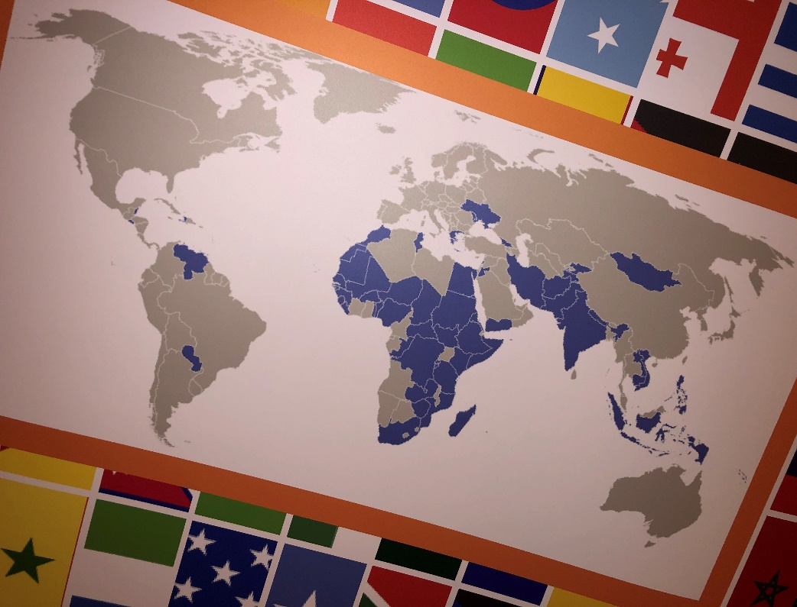
The UHC-Partnership Geneva, 20 June 2019

Slide 2
The UHC Partnership: 2011 – 2022
The “Universal Health Coverage Partnership” (UHC-P) aims at supporting WHO Member States in the development and implementation of health system strategies for Universal Health Coverage
The UHC-P started in 2011 with 7 countries and progressively expanded to reach about 66 countries in 2018 and 100+ from 2019 onwards.
Funded by the EU, Japan, Luxembourg and further joined by Ireland, France, Japan and United Kingdom. New donors are interested
In practice, the UHC-P provides support to Ministries of Health in the form of WHO technical assistance specialized in Health Systems for UHC (with focus on PHC) .

Slide 3
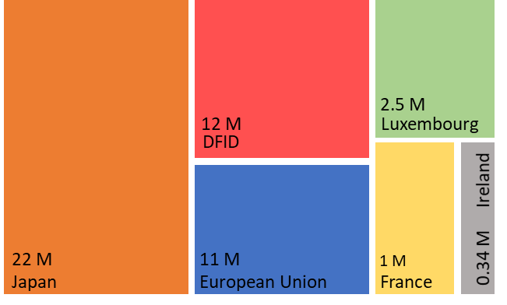
66 UHC Country Support Plans in 2018
MNCH & Immunization
97% of CSP activities are related to PHC
6 Donors ($51M forecasted in 2018)
Allocation of financial support to CSPs
MNCH & immunization 1%
NCDs & mental health 2%
Pharma & med prod. 3%
45%
55%
Information systems 9%
Service delivery 9%
Health workforce 9%
AMR 2%
Emergency, preparedness & response 3%
Activities
Staffing
Health financing 23%
Governance 39%
6
49
WHO Regional Offices
WHO Advisors on the Ground
>100 in 2019
3

Slide 4
194 WHO Member States
Mature
Health System
Maturing Health System
Vulnerable Health System
Extreme Vulnerability
04
Service Delivery Partner
03
Technical Assistance Partner
WHO Modalities
02
Strategic Supporter
01
Policy Dialogue Partner

Slide 5
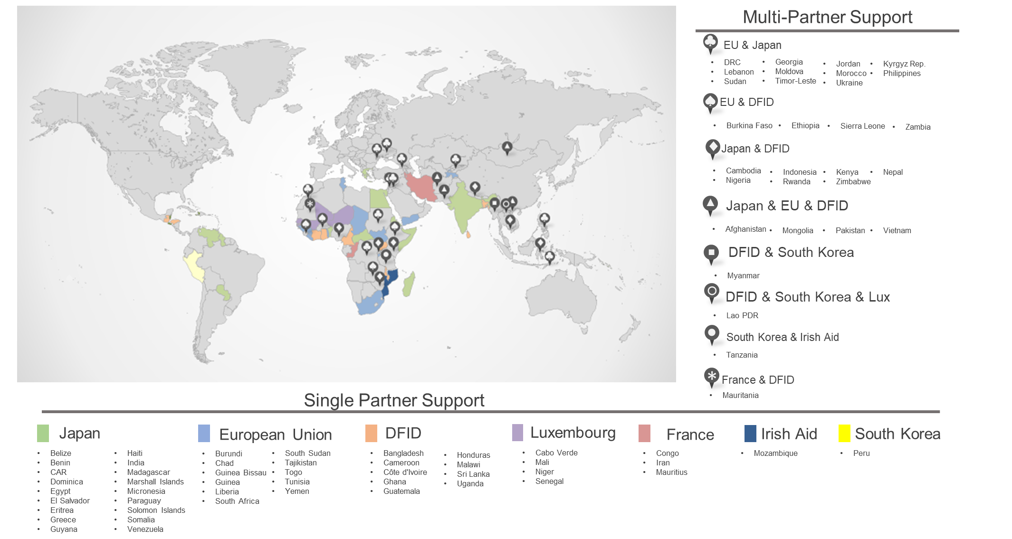
The UHC Partnership: Areas of work

Slide 6
Several examples
Guinea
Egypt
Costing of essential health services package
Pilot community-based health insurance fund
Training module for community health schools
Train local authorities on coordination of communities
Joint annual health sector reviews at all levels.
Costing & pricing of PHC and hospital care services to finalize the provider payment methods.
Pilot the Family Practice Model in through an integrated district health approach
Paraguay
Nepal
Finalize Basic Health Care Services Package (BHCSP)
Provincial governments capacity building on BHCSP
Health workers capacity building on BHCSP and quality
Develop Integrated Health Service Delivery Networks
Capacity building with emphasis on primary care.
Essential medicines & technologies selection for PHC
Strengthen supply and delivery of essential medicines
Greece
Cambodia
UHC Monitoring mechanism at primary care level to improve accountability of health providers.
PHC service delivery bottlenecks assessment
Expand coverage of essential health services provided in communities – enhance community engagement
Integrate NCD interventions into primary care services
Patients’ satisfaction survey on community-based PHC
Central/regional policy dialogue on PHC reform
Provide policy options to increase PHC public funding
Implement PHC pay-for-performance reimbursement

Slide 7
The future
Extension until 2022: New inputs from EU, Luxembourg, Japan under discussion, continuation with others
PHC is cornerstone to HSS for UHC
NCD needs to be better addressed in the framework of people centred integrated health services (prevention promotion care life course)

Slide 8
IHP+?
55 countries: coordination
40 countries: NHPSP
Feedback from countries (e.g. Sudan): improve coordination, Harmonisation and alignment
Timely – many new NHPSP
Better assess mutual accountability

Slide 9
Thank you

