Slide 1
OPENING SESSION

Slide 2
Recap: UN HLM Process and UHC2030 Consultation
Expected Outcomes: Member states agreed that the UN HLM will approve a concise and action-oriented political declaration, agreed in advance by consensus through intergovernmental negotiations, to be submitted by PGA for adoption by UNGA.
Added Value of the Political Declaration: UN HLM is a major opportunity to mobilise the highest political support for UHC as the cornerstone to achieving SDG3, unite health agenda together under a common theme and set UHC targets by 2023 and 2030.
Notes:
Graphic to be updated

Slide 3
Everyone, Everywhere
should have access to quality and affordable health services.
We call on Political Leaders
to legislate, invest and collaborate with all of society to make UHC a reality.
Notes:
To develop a set of key asks for the UN HLM, UHC2030 conducted three-month consultations with all actors of the UHC movement – parliamentarians, civil society, the private sector, agencies, networks and academia. The UHC Key Asks will feed into the UHC Political Declaration, and are the foundation for coordinated advocacy efforts that all partners can promote together throughout the preparation of the UN HLM, the Financing for Development Forum and the SDG Summit as well as other regional or economic fora in 2019.
Everyone, Everywhere
should have access to quality and affordable health services.
We call on Political Leaders
to legislate, invest and collaborate with all of society to make UHC a reality.

Slide 4
The UHC Key Asks from the UHC Movement
6 Key Asks, 6 Milestones and 36 Action Agenda
1
2
3
4
5
6
NOTE: Co-chair letter about UHC Key Asks already sent to HOS, MOF, MOFA and MOH.
Notes:
We have 6 key asks and 6 milestones with 36 action agenda to support key asks.
1. Ensure Political Leadership Beyond Health – Commit to achieve UHC for healthy lives and well-being for all at all stages, as a social contract.
2. Leave No One Behind – Pursue equity in access to quality health services with financial protection.
3. Regulate and Legislate – Create a strong, enabling regulatory and legal environment responsive to people’s needs.
4. Uphold Quality of Care – Build quality health systems that people and communities trust.
5. Invest More, Invest Better – Sustain public financing and harmonise health investments.
6. Move Together – Establish multi-stakeholder mechanisms for engaging the whole of society for a healthier world.
Action Agenda is not included in the slides, so please refer the distributed brochure. We will also hear from our partners more details about the key asks and action agenda during the Hearing.

Slide 5
Across Cutting Agenda
Gender Equality / Women’s and Girls’ Rights
We recognise the critical importance of gender equality for the achievement of UHC, including protecting, respecting and fulfilling women’s and girls’ rights, changing harmful gender norms and eliminating political, economic and social gender barriers that prevent all people, however they identify their gender, from enjoying their right to health.
We urge political leaders to re-commit to gender equality, redress gender power dynamics and ensure women’s and girls’ rights as foundational principles for UHC.
NOTE: Gender Equality / Women’s and Girls’ Rights was added to the last page of the brochure as a box with endorsement by SC.

Slide 6
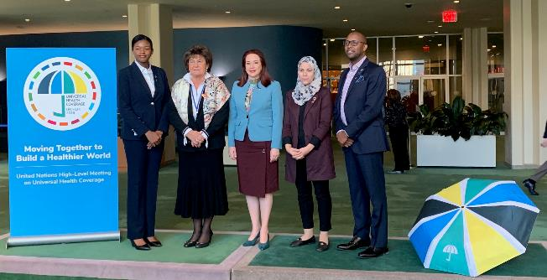
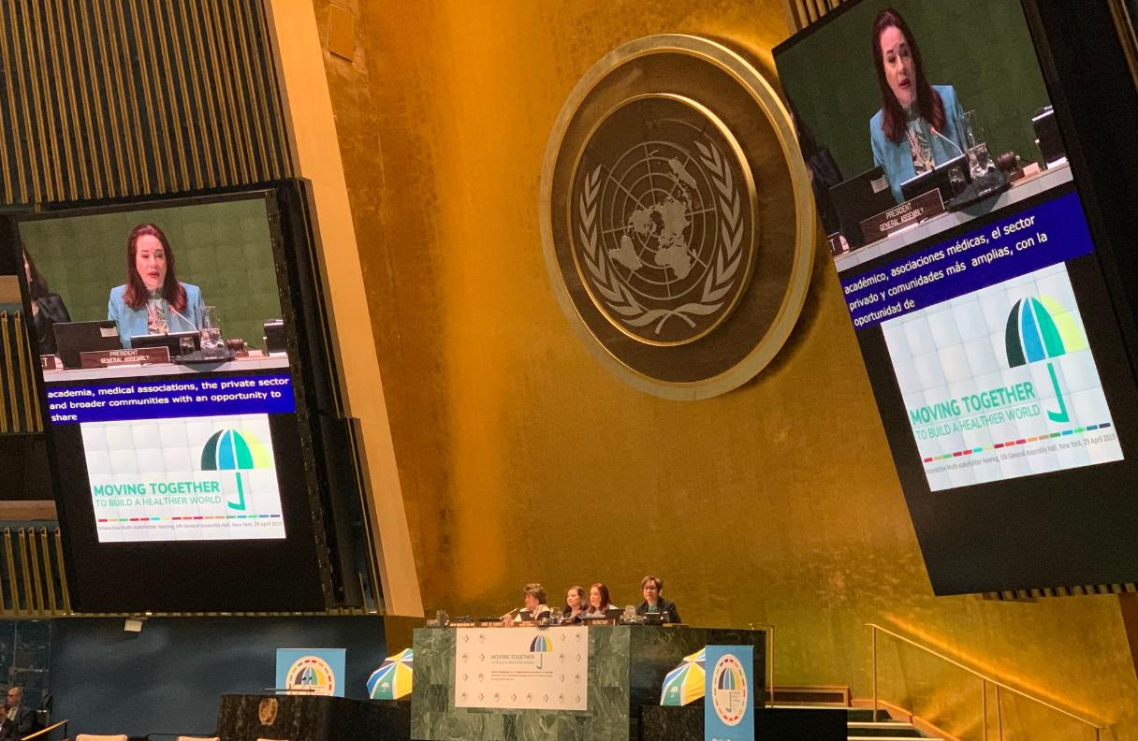
www.UHC2030.org
info@UHC2030.org
@UHC2030 #UHC2030

Slide 7
SESSION1 – GETTING OUR ASKS ADOPTED:
LEVERAGING THE FULL POTENTIAL OF THE UN-HLM

Slide 8
Table of Contents
Further actions to take before and after September
Preparation for UN HLM
UHC2030’s plan during the UNGA high-level week

Slide 9
Further actions to take before and after September
Key remaining action points for UHC2030
Ambitious targets by 2023 & 2030:
Health spending targets – public spending at XX% of GDP for XX
UHC monitoring targets – SDG 3.8.1 and 3.8.2 indicators
Follow up mechanisms and actions:
Request to the UN Secretary-General to champion UHC agenda
Potential role of UHC2030 to support follow up actions
Key areas and elements:
Redlines and missing pieces to maximize agreed messages of UHC Key Asks
NOTE: Co-chair letters about our further actions to send to PGA-elect, UNSG, GOF of UHC after the June UHC2030 SC.

Slide 10
Political Declaration – ambitious target by 2023 and 2030
Health Spending Targets:
Zero draft para 34: encourage countries, especially those that have not yet achieved the minimum target of 5% of GDP for public spending on health, to increase public spending at an additional 1% to 2% of GDP for expanding access for all to nationally determined sets of essential health services, with a view to achieving such target or higher by 2030;
Key Asks: Set nationally appropriate spending targets for investments in health (e.g., ideally at least 5% of GDP on public health spending) consistent with sustainable national development strategies, and ensure efficient and equitable allocation of resources to PHC.

Slide 11
Political Declaration – ambitious targets by 2023 and 2030
Financial Protection:
Zero draft para 64: stop the rise of catastrophic out-of-pocket health spending [by 2023] by providing financial risk protection and reverse the trend by 2030;
Key Asks: By 2023, make progress in mobilising domestic pooled funding and reduce catastrophic health expenditure.
Service Coverage:
Zero draft para 64: progressively cover one billion additional people with quality essential health services and quality, essential, affordable and effective medicines, vaccines and technologies for all by 2023, and an additional two billion people by 2030;
Key Asks: By 2023, the coverage of quality essential health services has been delivered to one billion additional people.

Slide 12
Political Declaration – follow up mechanisms and actions
Request to the UN Secretary-General to champion UHC agenda (Zero Draft):
Zero draft para 65. Request the Secretary-General, in close collaboration with the WHO, development partners and other relevant initiatives, such as the Global Action Plan for Healthy Lives and Well-Being for All and the International Health Partnership for UHC2030, to promote a multiagency network for all health-related SDGs hosted by the WHO, to provide guidance and assistance to Member States towards the achievement of UHC;
Zero draft para 66. Request the Secretary-General to continue engaging with Member States to sustain the political momentum on UHC and to provide, in consultation with the WHO, every two years beginning from the seventy-sixth session, a monitoring report on the progress of Member States in all health-related SDGs, in particular on moving towards UHC across all relevant sectors, including on the implementation of the present declaration, at all levels, which will also serve to inform the preparations for a high-level meeting on health in 2023 to be attended by Heads of State and Government in New York, aimed to undertake a comprehensive review of all health-related SDGs under the UHC umbrella, identify gaps and solutions to accelerate progress towards achieving UHC by 2030.

Slide 13
Political Declaration – follow up mechanisms and actions
Potential role of UHC2030 to support follow up actions:
Cross-programatic advocacy efforts with UHC2030 partners and related initiatives to amplify key messages of the political declarations both at global and country levels;
Strategic approach to coordinate efforts of various existing initiatives and UN HLM follow up mechanisms by 2023 under the UHC umbrella;
Joint approach to address funding gap and investment fragmentation in health; and
Contribution to monitoring and accountability (to be discussed more detail in the session 1.2)

Slide 14
Political Declaration – Key areas and elements
Redlines and missing piece to maximize elements from UHC Key Asks
Political messages may be not easy to communicate and remember for heads of states level
Social contract and social accountability are not well articulated
Financial support to civil society and community groups missing
Link to FfD and HLPF agenda are not strong enough (e.g. fight tax evasion and corruption, investment in public goods, data disaggregation, HLPF VNRs and thematic reviews)
Anything else?

Slide 15
Link to FfD and HLPF agenda
E/FFDF/2019/3: Report of ECOSCO forum on FfD follow-up
9. We recognize that investments and innovation in the social sector, in particular in education and health, contribute to the alleviation of poverty and reduction of inequalities and enhance human resource development, and we encourage further efforts to scale up investments in these areas through quality education that is inclusive and equitable and universal health coverage, among other things...
Second draft of the SDG Summit political declaration – our call to accelerate action
Leaving no one behind;
Mobilizing adequate and well-directed financing
Enhancing national implementation
Strengthening instates for more integrated solutions
Bolstering local action to accelerate implementation
Building resilience
Solving challenges through international cooperation and enhancing the global partnership
Harnessing science, technology and innovation with a greater focus on digital transformation for sustainable development
Investing in data for the Sustainable Development Goals
Strengthening the high-level political forum

Slide 16
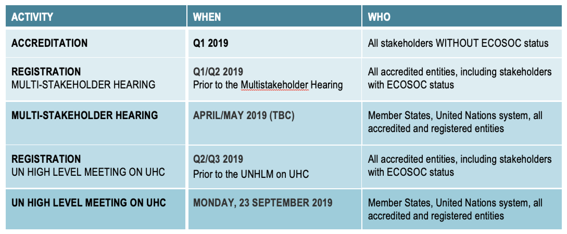
Preparation for UN HLM, 23 September in New York
Accreditation and Registration Process to participate UN HLM
29 APR 2019
July 1/Early-August 2019 (TBC)

Slide 17
Preparation for UN HLM, 23 September in New York
Two Multi-stakeholder Panels
Member states encourage inclusion of civil society and private sector in member state delegations, including UHC eminent speaker in the opening segment and invitation of other accredited organizations to the UN HLM.
Two multi-stakeholder panels will be held in parallel to the plenary segment, one from 11:00 to 13:00 and the other from 15:00 to 17:00.
PGA may invite parliamentarians, local governments, the heads or senior representatives of relevant United Nations entities, development partners, civil society, the private sector, academia, medical associations, indigenous leadership and community organizations to serve as speakers on the panels.
Theme of the Multistakeholder Panels will be:
UHC as driver of equity, inclusive development and prosperity for all
Accelerate multi-sectoral and multi-stakeholder actions and investments for achieving UHC

Slide 18
UHC2030’s plan during the UNGA high-level week
September 22nd
Walk the Talk – Health for All challenge in NY
Venue: Central Park
Time: morning
UHC2030 Private Sector event
Venue: Outside of UN building (TBC)
Time: lunch time
UHC2030 CSEM event
Venue: Outside of UN building
Time: afternoon (TBC)
September 23nd
Climate Action Summit
UN High‐level meeting on UHC in 2019
September 24th and 25th
SDG Summit
UHC2030 Strategic meeting on follow up actions and UHC joint efforts by 2023
Venue: Rockefeller Foundation
Time: daytime (TBC)
September 26th
First High‐level Dialogue on Financing for Development
UHC2030 High‐level event on coordinated actions and UHC joint efforts by 2023
Venue: DDR, UNHQ (TBC)
Time: breakfast (TBC)
Other potential events organized by partners (list to be completed):
Parliamentarian breakfast event (IPU) – 23rd Breakfast or Lunch (TBC)
Africa Leads the Way (Access Challenge) – 23rd Evening
Financing Common Goods (WHO) – 24th Morning, Scandinavia House
SDG3 GAP Launching event (WHO) – 24‐25th (TBC)
High-level event (Stop TB…etc) – 24th , West Terrace (TBC)
Climate and Environmental Impact on Health (NCDA), 25th (TBC)
Social Participation event (WHO/UHC2030) – TBC
UHC Global Monitoring Report Launching event (WHO/World Bank) ‐ TBC
NOTE: UHC2030 is looking for co-organizers of some of events.

Slide 19
www.UHC2030.org
info@UHC2030.org
@UHC2030 #UHC2030

